Slide 1
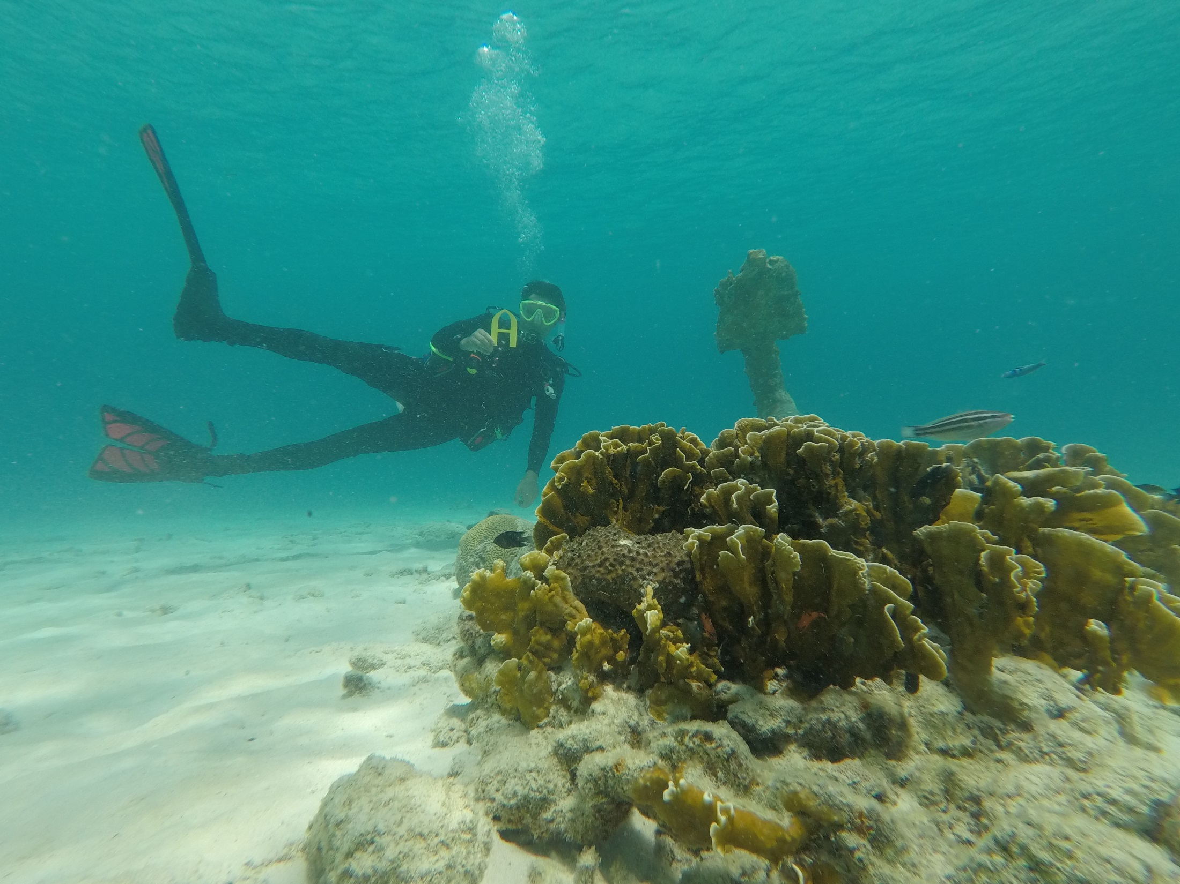
Why Bonaire
for J-term?
It’s not Illinois in January;
it’s the southern Caribbean!

Slide 2
Answers to FAQs about the Bonaire 2022 J-term geology program…
2022 Program Overview
Spend 2 weeks in the Netherlands Antilles island of Bonaire doing field work in Geology and exploring how this Caribbean island came to exist. The program offers coursework at two levels, a100-level introductory course for newcomers to the geological sciences, and a 300-level advanced course for majors and minors with a Geology or Biology background.
Students will spend the first week of J-Term on campus, learning the science behind geologic processes, and then head off to Bonaire, where they will see first-hand, both above and beneath the waves, just how the island came to be. Ocean swimming is integral to this program, so knowing how to swim is a requirement (all students must pass a pre-trip swim test). Spending time on the living (underwater) reef is also a highly valuable experience – integral to the program design – so SCUBA certification is very strongly advised; Augustana will offer a special HEPE SCUBA course during Fall term 2021 for Bonaire J-Term participants (however, snorkeling is a option).
Eligibility & Program Cap
Requires a ≥2.00 GPA and sophomore or older status. Open to all majors, however the upper-level course option does have prerequisites: GEOL 201 or BIOL 200. Program target is 20 students, 10 at each course level.
Courses & Credits
This program offers parallel 4-credit courses at two levels of experience with Geology (students in both courses will work together on-island):
GEOL 123 (PN): Build Me An Island: Introduction to geology through study of processes of island formation.
GEOL 321 (PN): Carbonate Sedimentology & Paleoecology. This upper-level course in field research is for students with a background in Geology or Biology. Prerequisite: BIOL 200 or GEOL 201.
Program Costs
Tentative fee: $3,995 (Augie Choice available to Juniors and Seniors).
Cost Includes: Airfare, lodging, on-island SCUBA diving, on-island breakfasts & lunches, excursions, ground transportation, park entrance fees, and standard health insurance; no discount for snorkel-only option.
Does not include: basic gear (mask, fins, snorkel, wetsuit, waterproof flashlight), dinners, food during travel to/from Bonaire, discretionary spending, Passport or vaccination fees, $180 PADI SCUBA certification fee, if you’re not already certified, and required $77 DAN dive membership & dive insurance.
Faculty Contacts
For more information, please contact geology professors:
Dr. M. Wolf (michaelwolf@augustana.edu) or Dr. K. Arkle (kelseyarkle@augustana.edu)

Slide 3
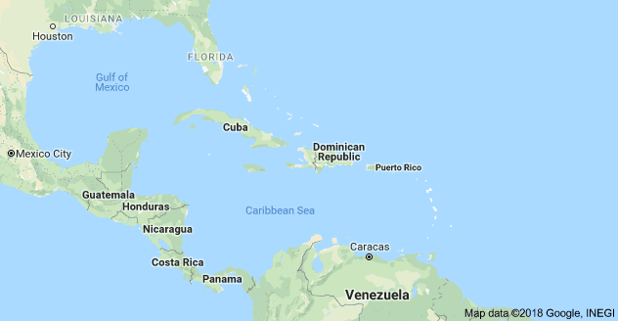
An oft-stated geologic maxim, “if you want to be a better geologist, you need to see more rocks” is a guiding principle for this program, even though many of you are not geologists. Even if you’re not a science major, truly understanding how science is done is fundamental to your liberal arts education; our modern world requires us to logically evaluate all sorts of complex information, and deepening your knowledge of the scientific method will enhance your abilities to make rational decisions in many aspects of your life.
You will learn to understand the natural world better by observing its subtle and not-so-subtle geologic features with focused intensity. We caution you that you’ll never view another mountain, cliff, beach, or any geologic feature in quite the same way; you will forever need – and be able – to interpret and understand the wonders of the Earth – it’s called the geologist’s “curse” !!
area of next slide

Slide 4
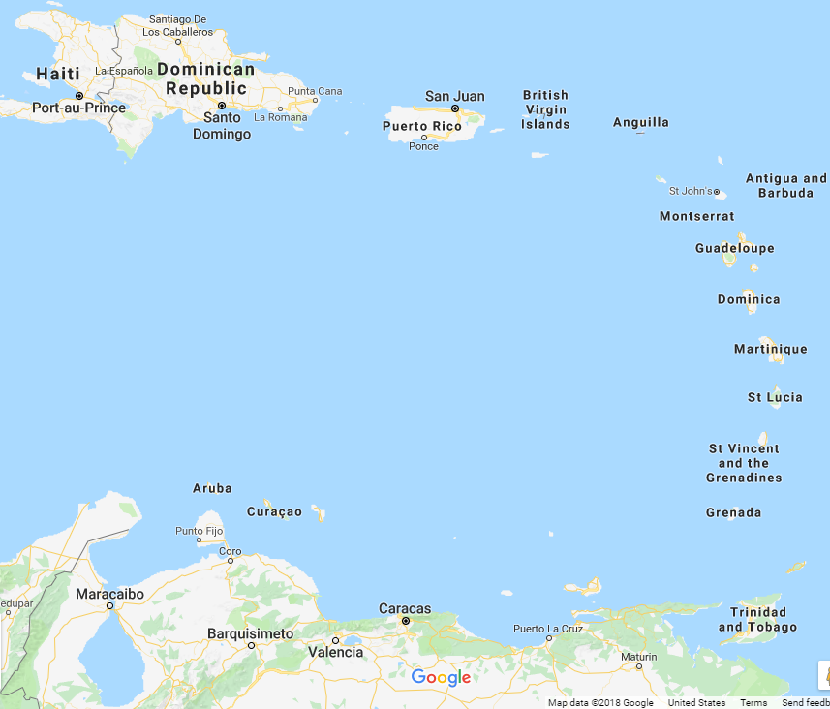
Bonaire – the “B” in the “ABC” islands of the Netherland Antilles.
~50 miles off the north coast of Venezuela, but it’s Dutch;
languages spoken are Dutch, English, Spanish, & Papiamentu,
but they use the US dollar!
Bonaire (~12° N. Latitude)
~200 miles

Slide 5
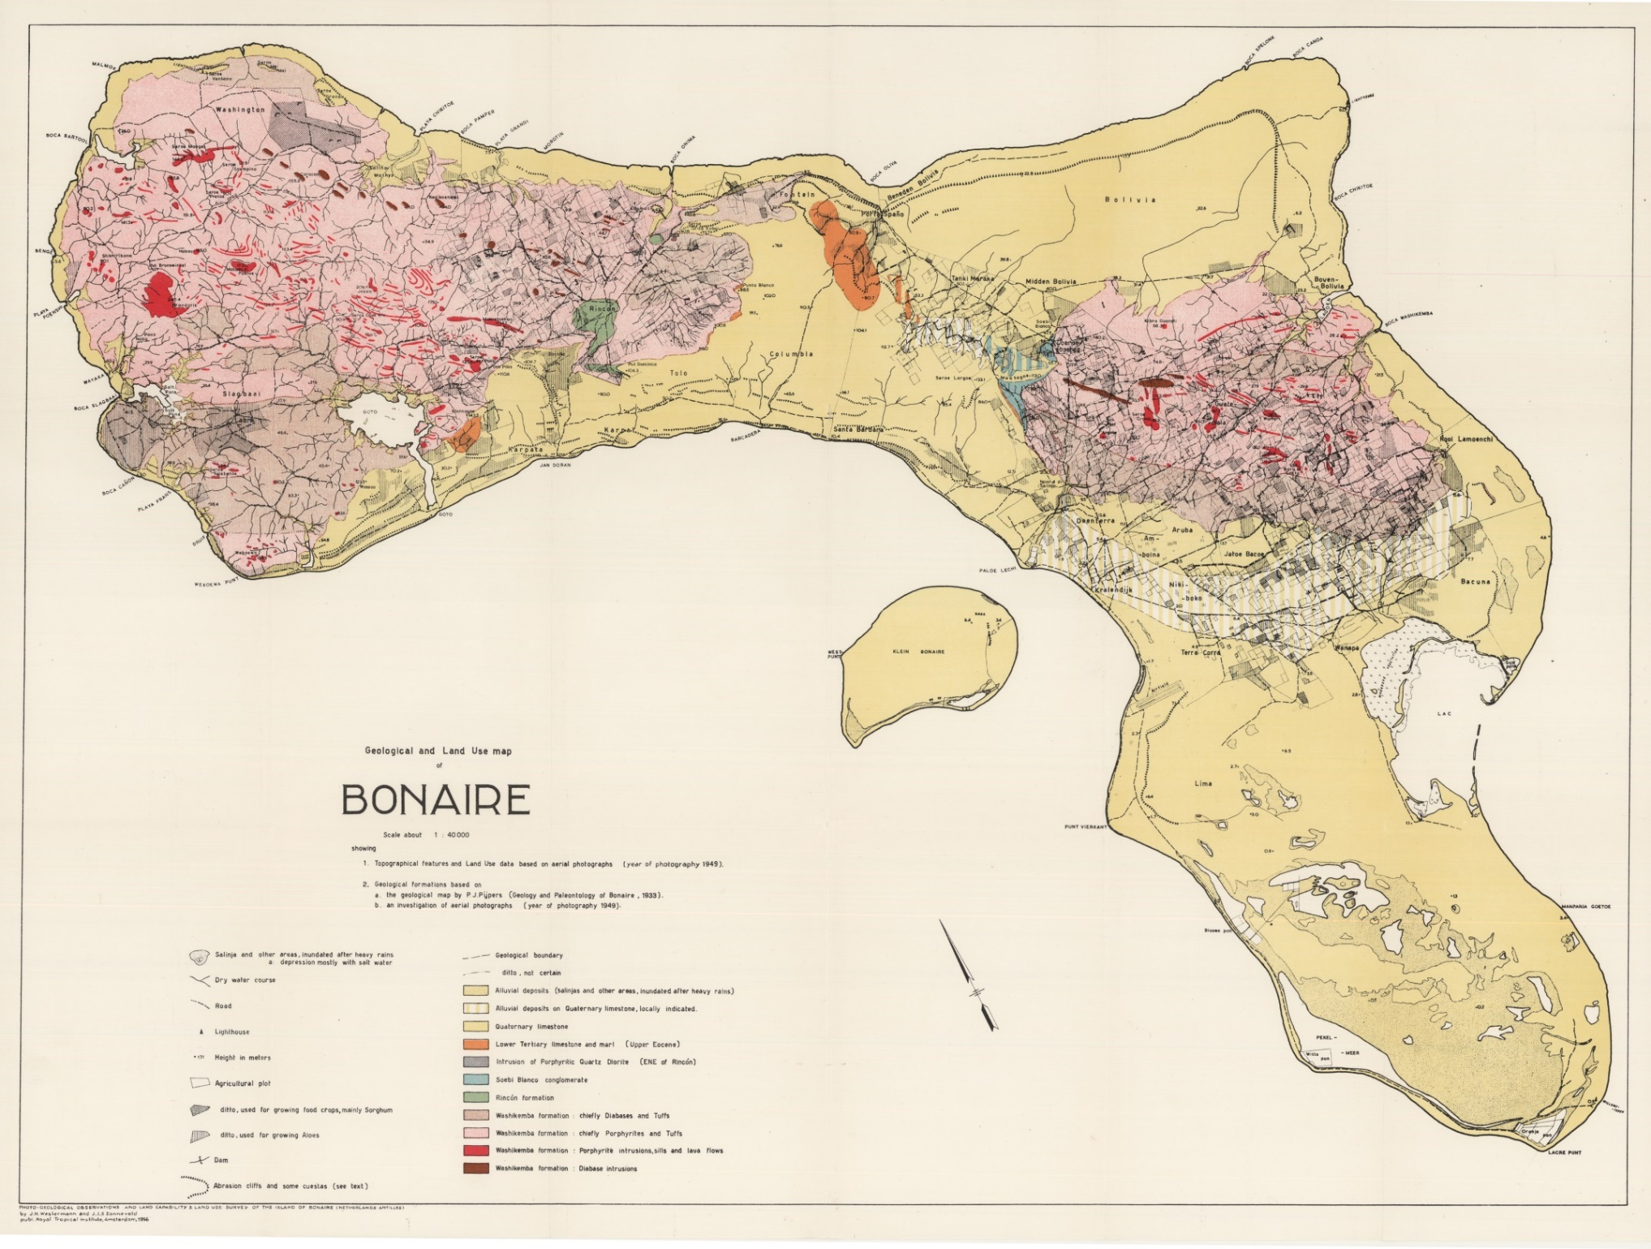
A wide array of well-exposed rocks to study. A perfect place to do field work.
Igneous Rocks
Sedimentary Rocks

Slide 6
Surprisingly, it’s a desert island, so those rocks are well-exposed, but
sometimes the desert flora impedes our search for rock outcrops!

Slide 7
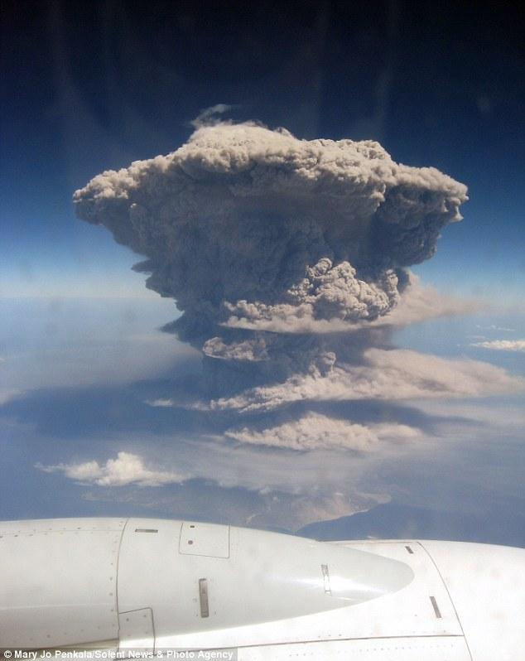
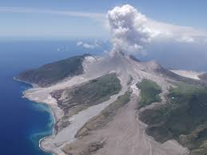
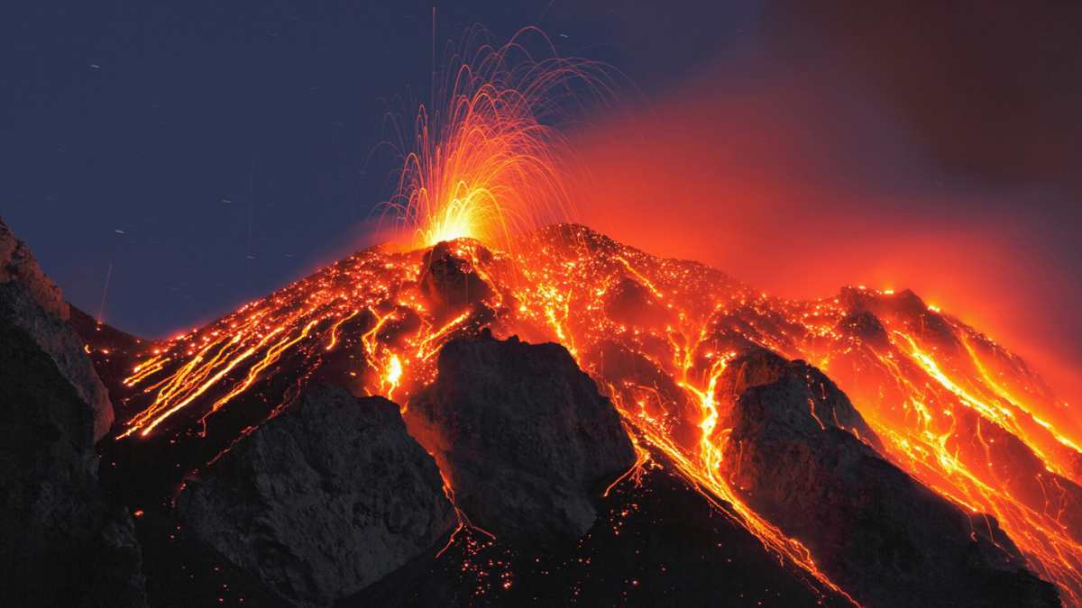
The mountains are igneous rocks, which means there were volcanoes there
in the past, like the active one on the West Indies island of Montserrat !
( But don’t worry, they’re not
active on Bonaire! )

Slide 8
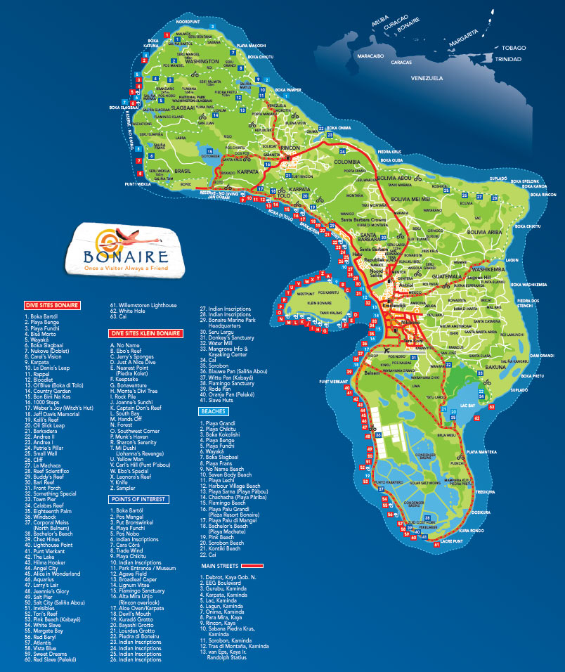
But the reefs are active
and pretty much fully
surround the island,
and reef-forming
processes create the
sedimentary rocks.
We’ll study the ancient
reefs exposed on land
and the modern reefs
still underwater.
Map of dive locations

Slide 9
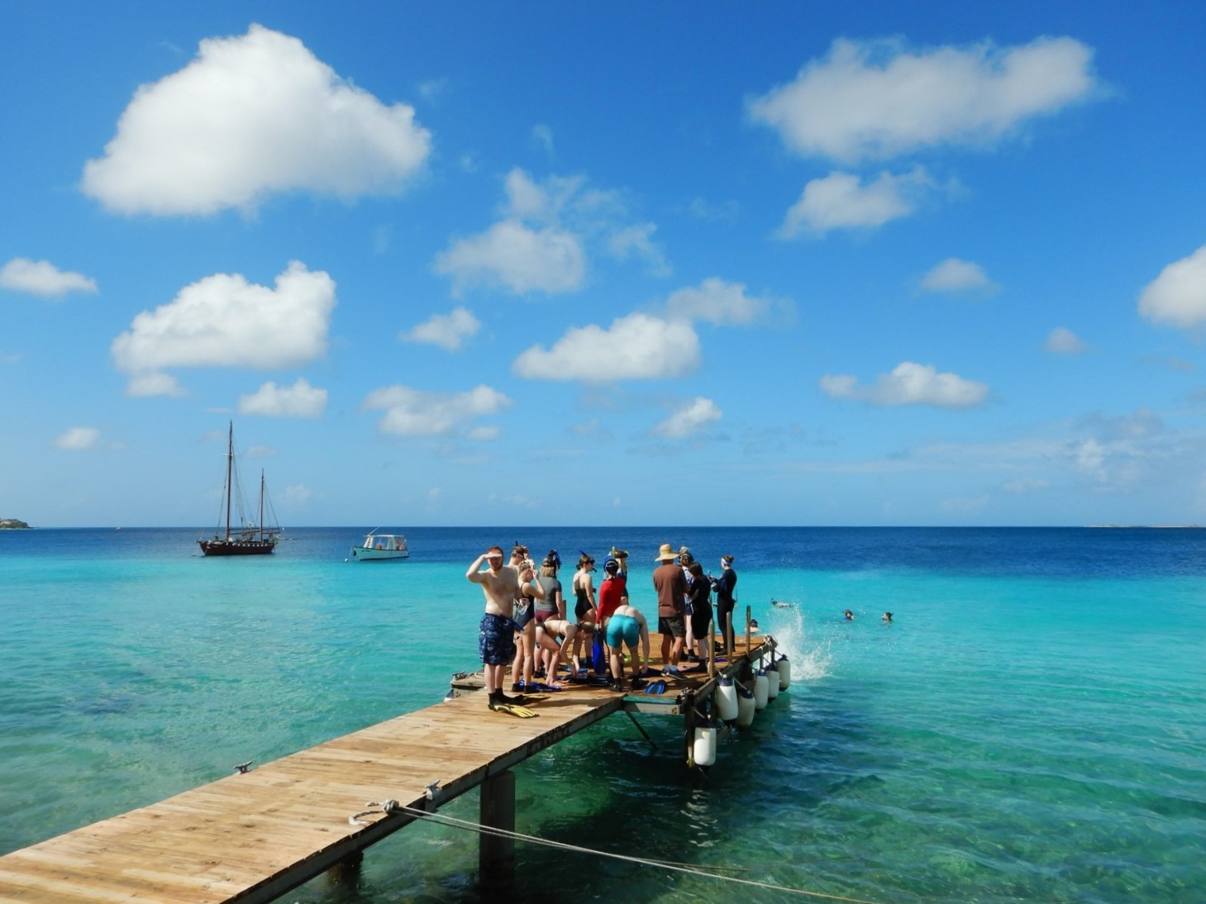
We’ll be staying at the Carib Inn, in Kralendijk (“Crawlen-dike”), which has its own pool,
dock, dive boats, and full-service dive shop. All rooms have access to a kitchenette, for those who chose to cook their own dinners (we’ll make frequent grocery runs for supplies).
Tap drinking water is all distilled & purified. Most food is flown in daily from The Netherlands except the baguettes and croissants – they’re made fresh on-island every morning. Life is Gouda! Average January temps: 86°F high / 77°F low; bring sunscreen.

Slide 10
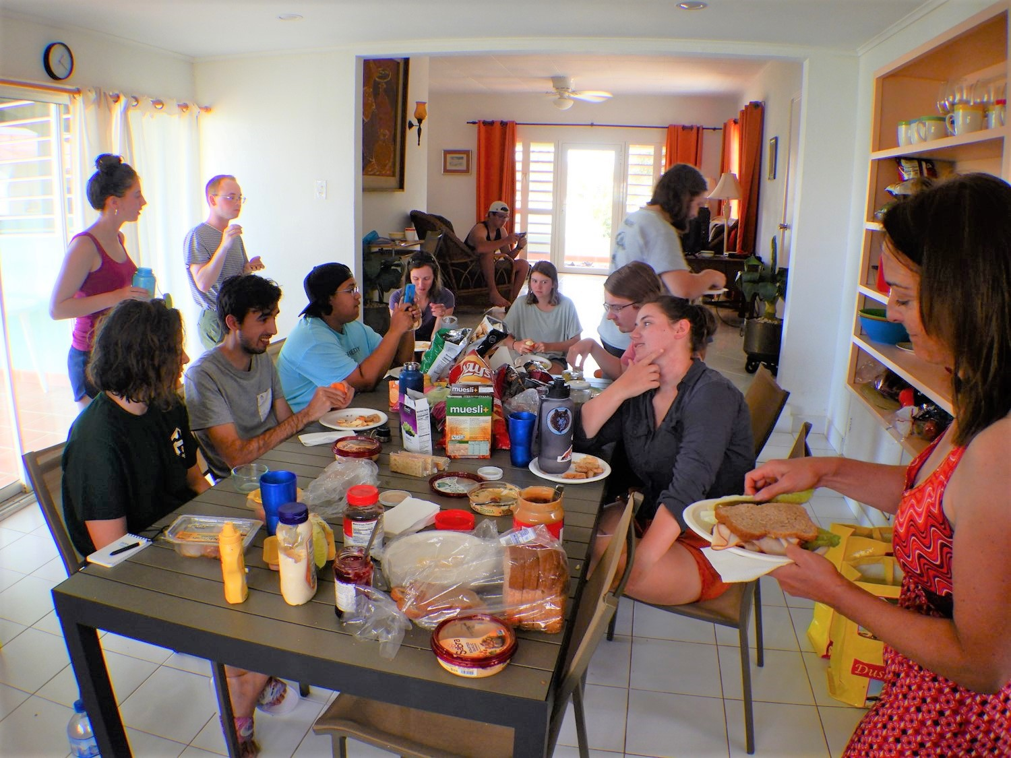
Communal lunches and breakfasts at home or on the outcrop.

Slide 11
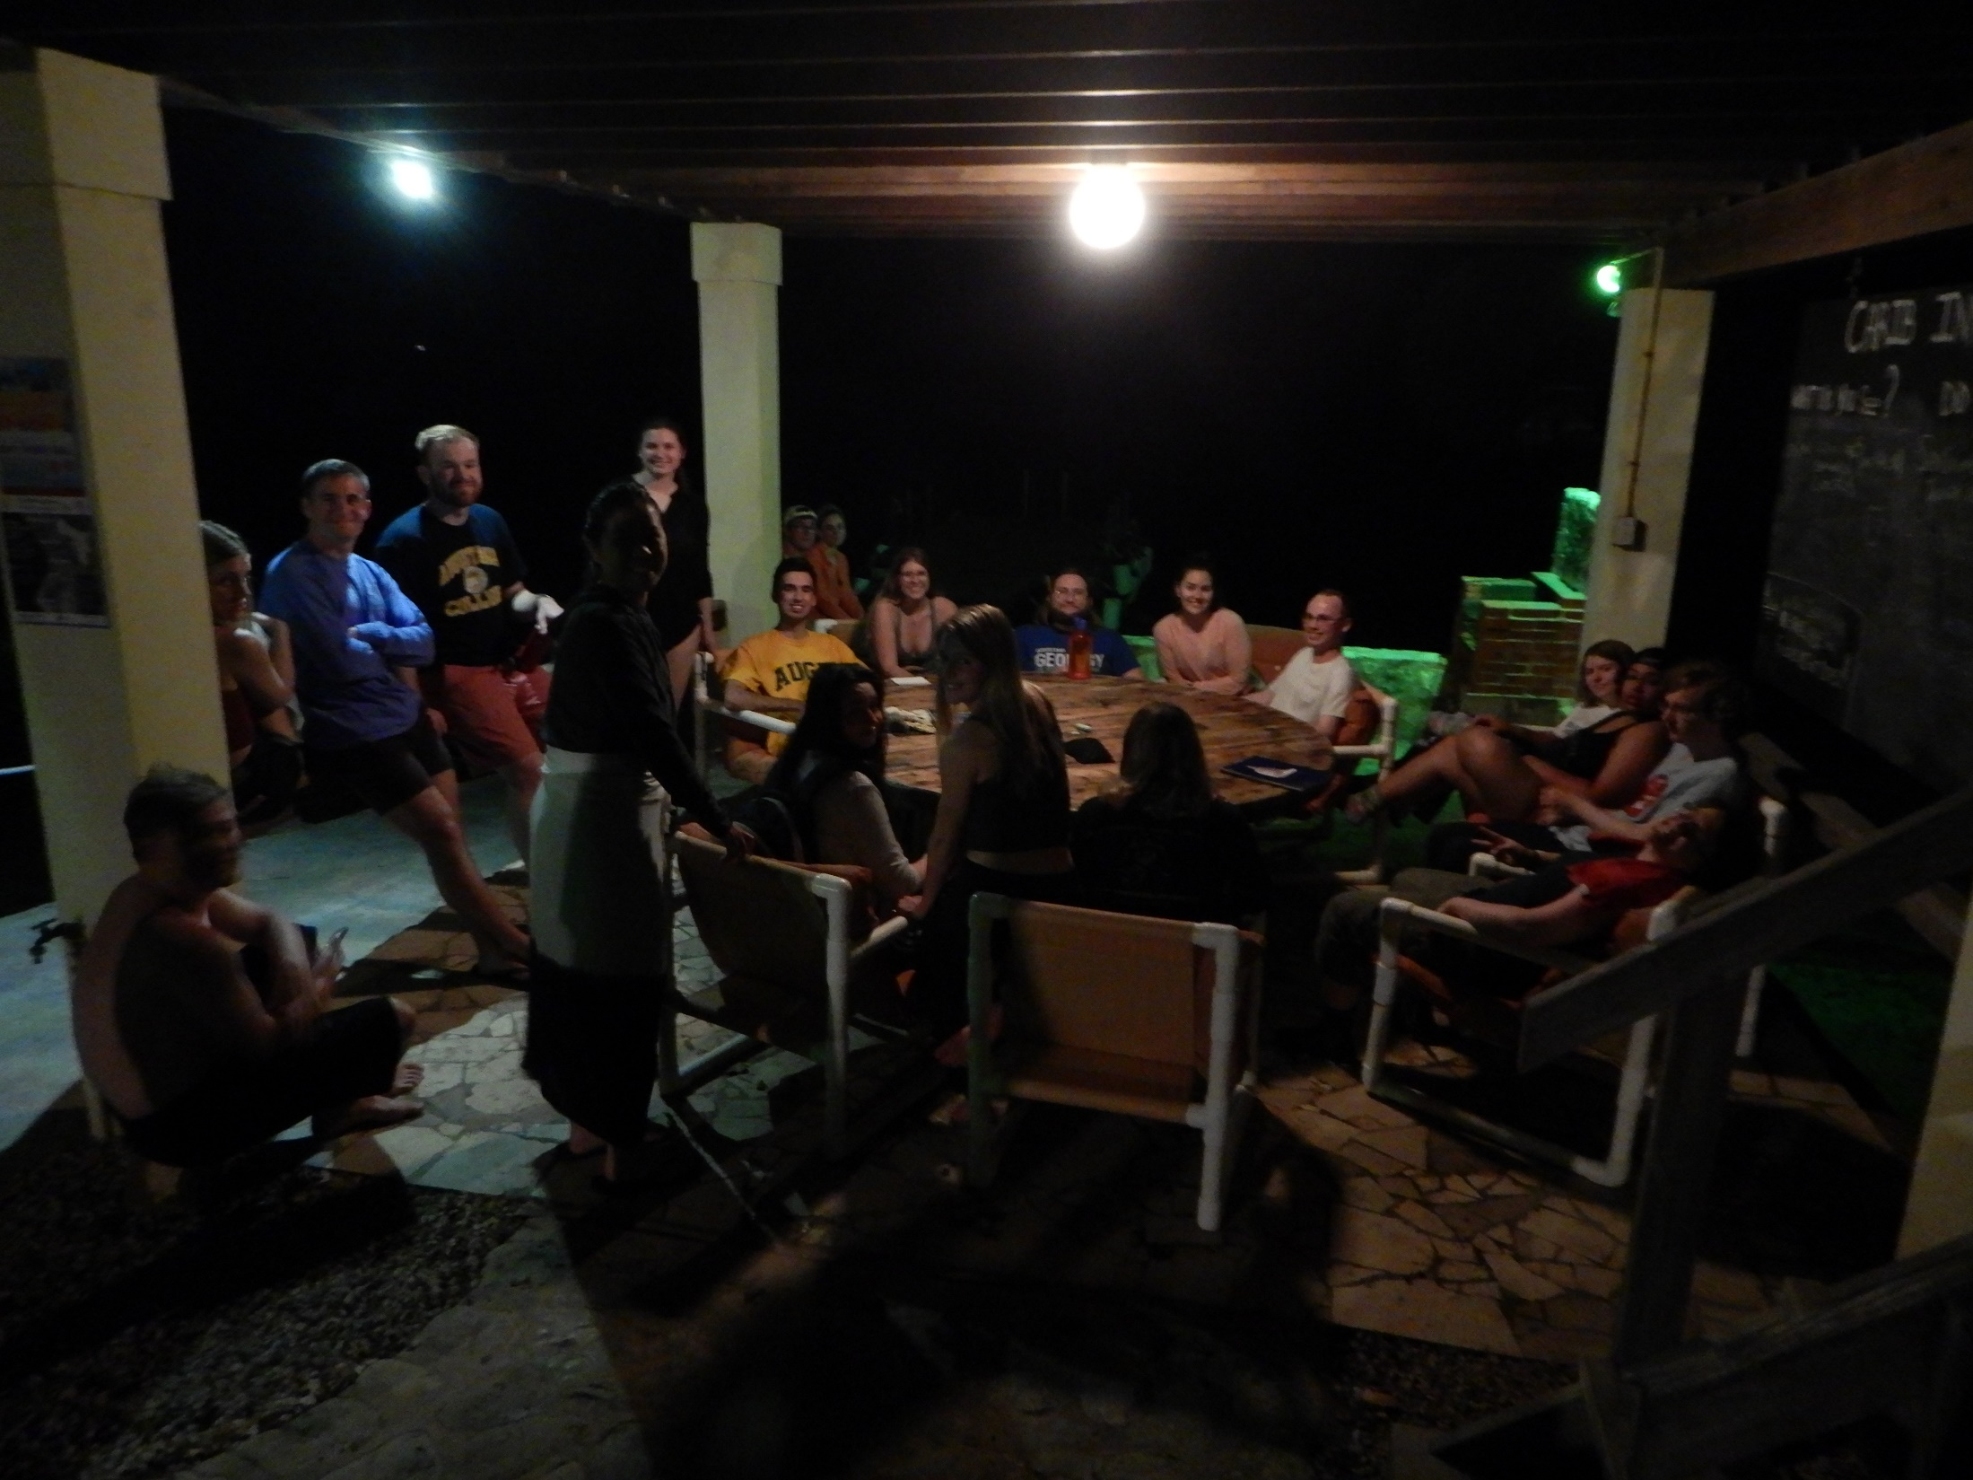
Nighttime camaraderie and study sessions

Slide 12
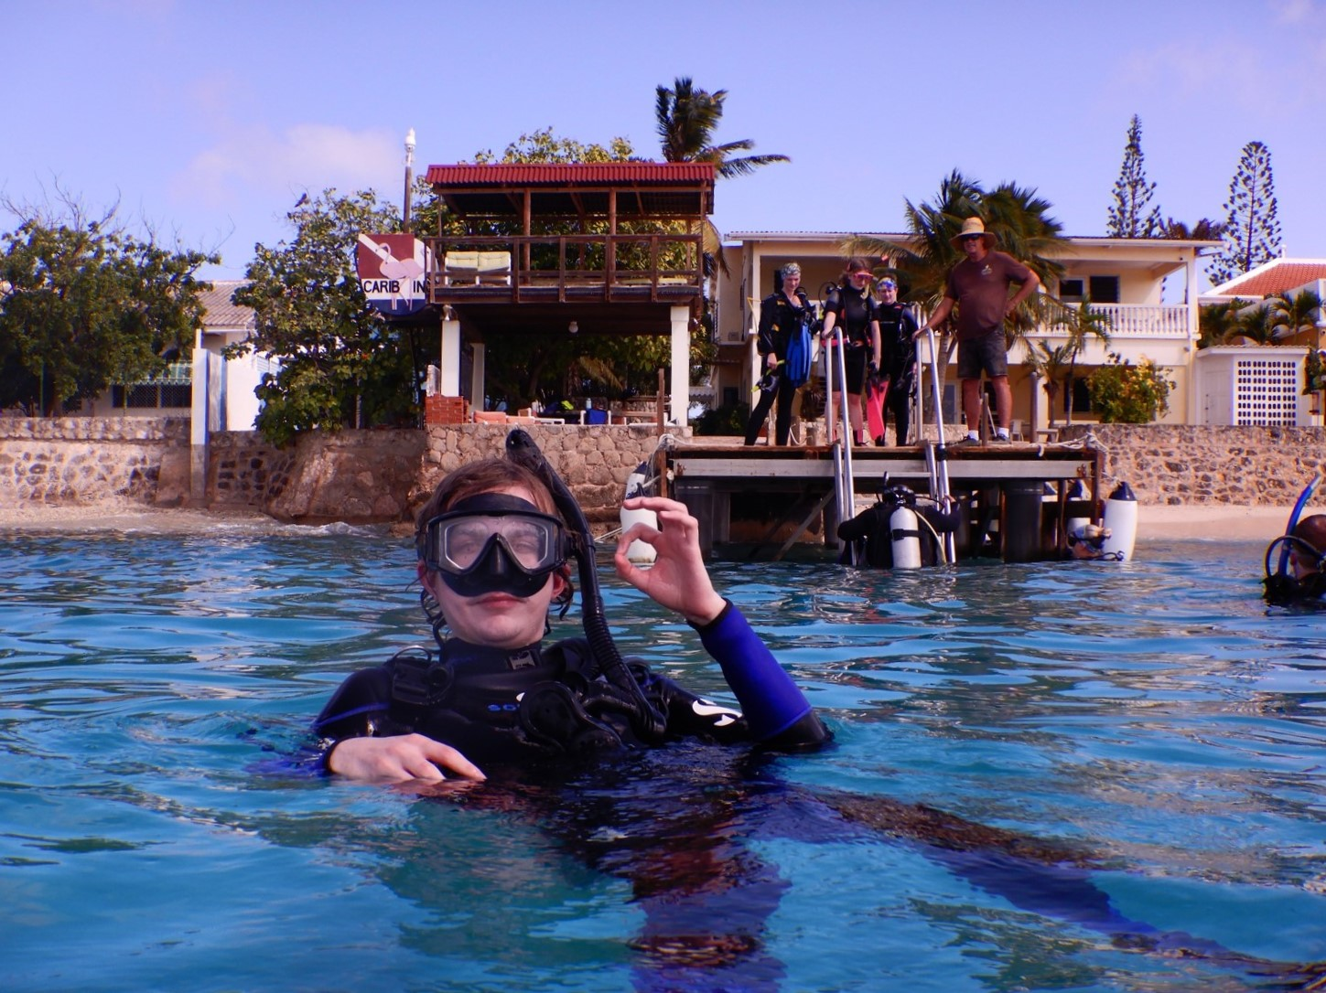
Access to the ocean reefs from the Carib Inn is as easy as walking off the dock!

Slide 13
But we’ll also drive to many of our dive spots around the island.

Slide 14
And we’ll use boats to reach other dive spots.

Slide 15
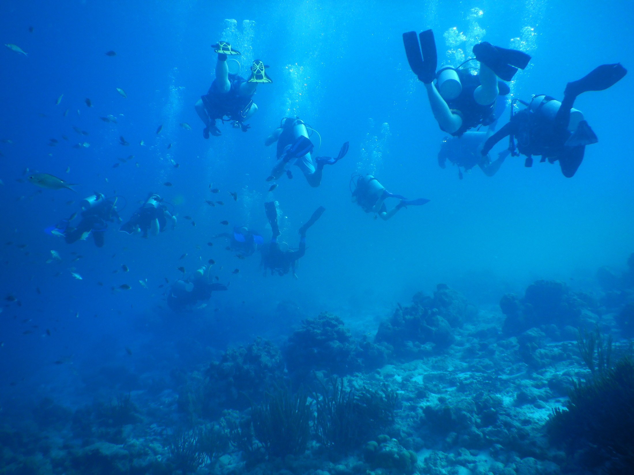
Orientation dives allow all to gain experience and comfort with open ocean SCUBA diving…

Slide 16
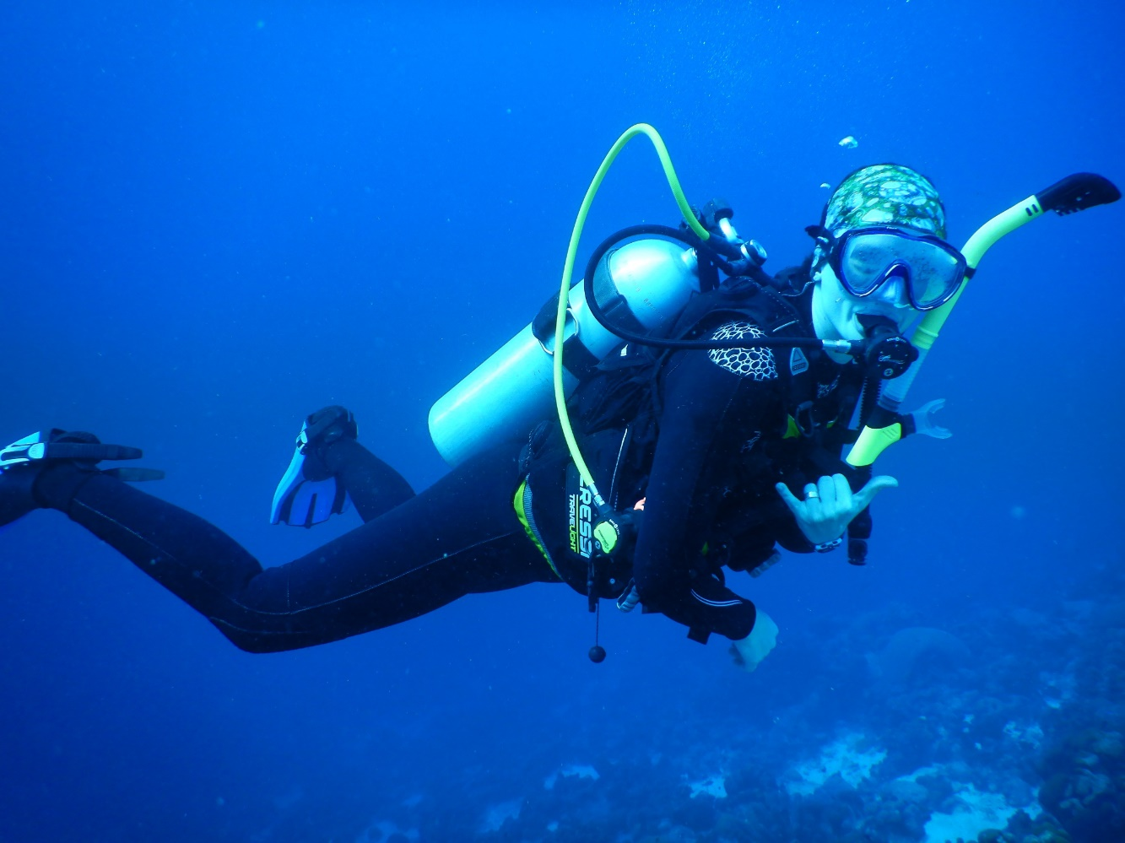
… comfort which comes quickly. The buddy
system is strictly enforced, of course; safety
is always the highest priority.
PADI or SSI SCUBA certification is required for any SCUBA diving; we strongly recommend all
program participants to get certified and partake in the planned SCUBA diving activities.

Slide 17
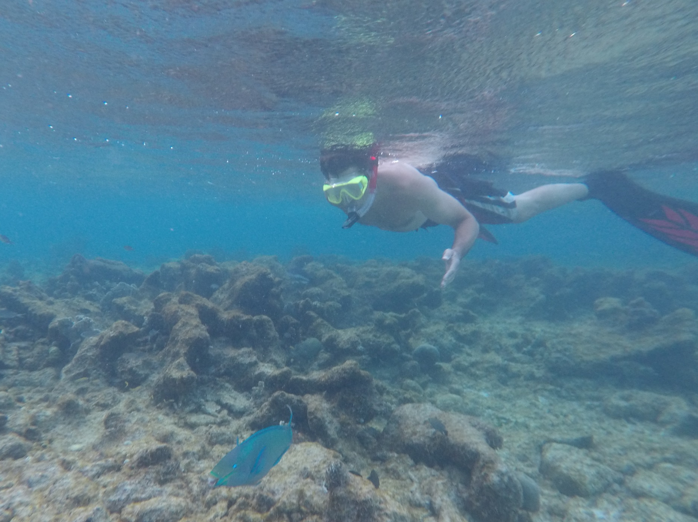
However, snorkeling is an option, though there is no cost savings for not SCUBA diving. All
participants need to purchase mask, snorkel, fins, and wet suit. You may bring your own BCD (Buoyancy Compensator Device) and regulator, but if you don’t want to purchase them for this trip, the cost of renting them are included in the price of the program.

Slide 18
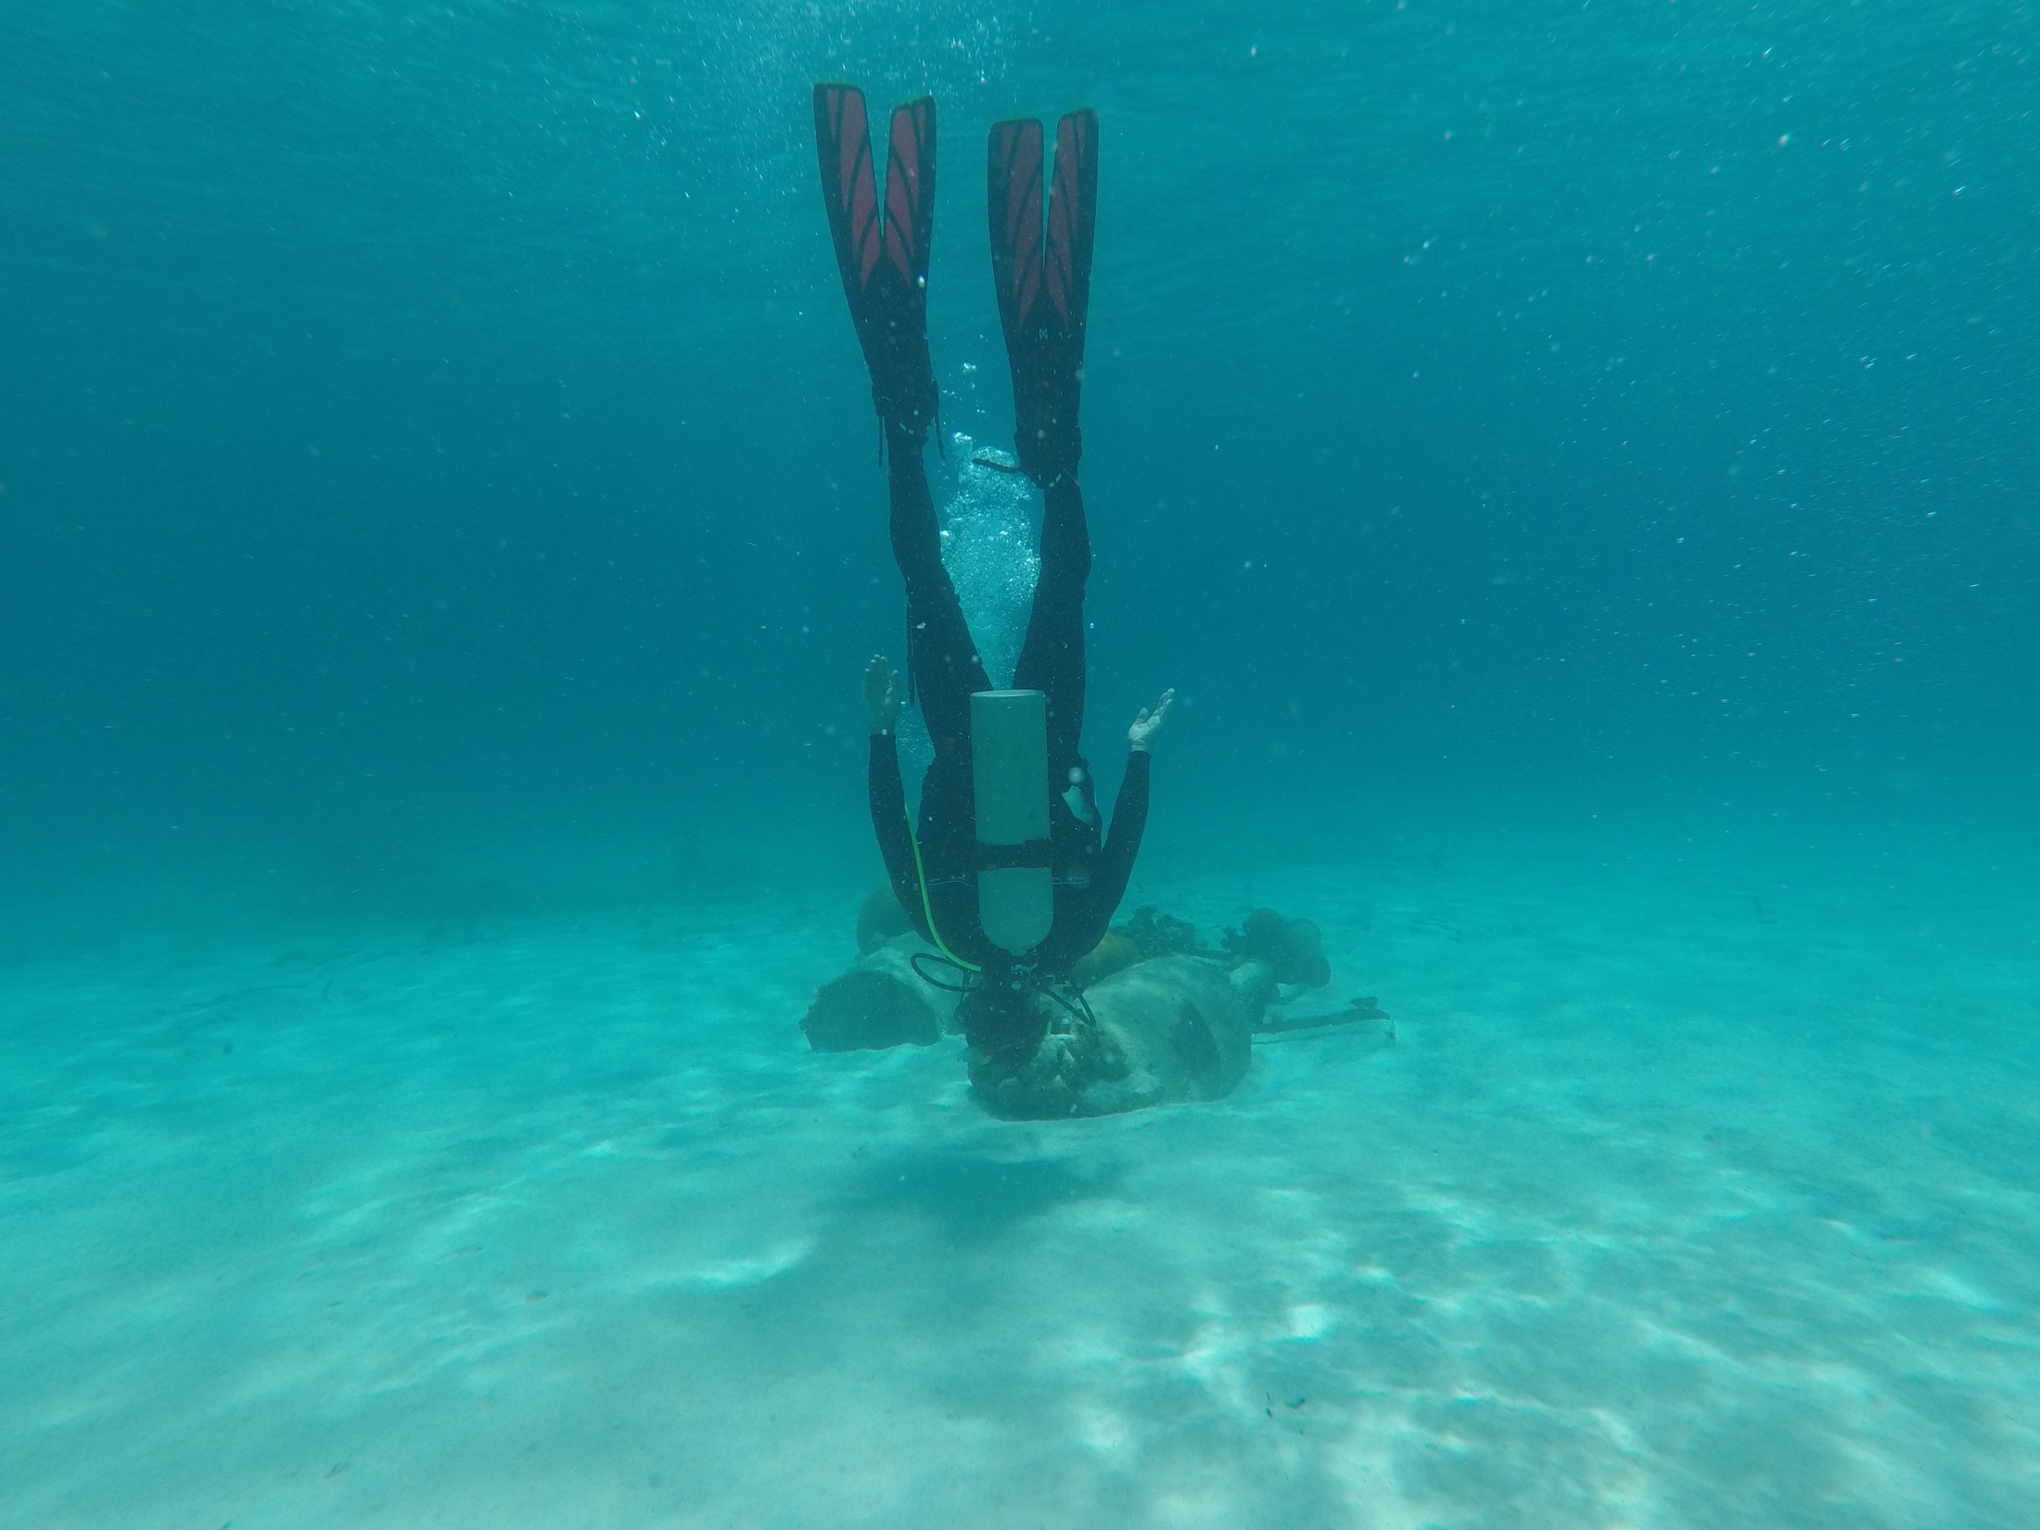
SCUBA diving allows one to see the world in a new perspective (this is, after all, a water planet)!

Slide 19
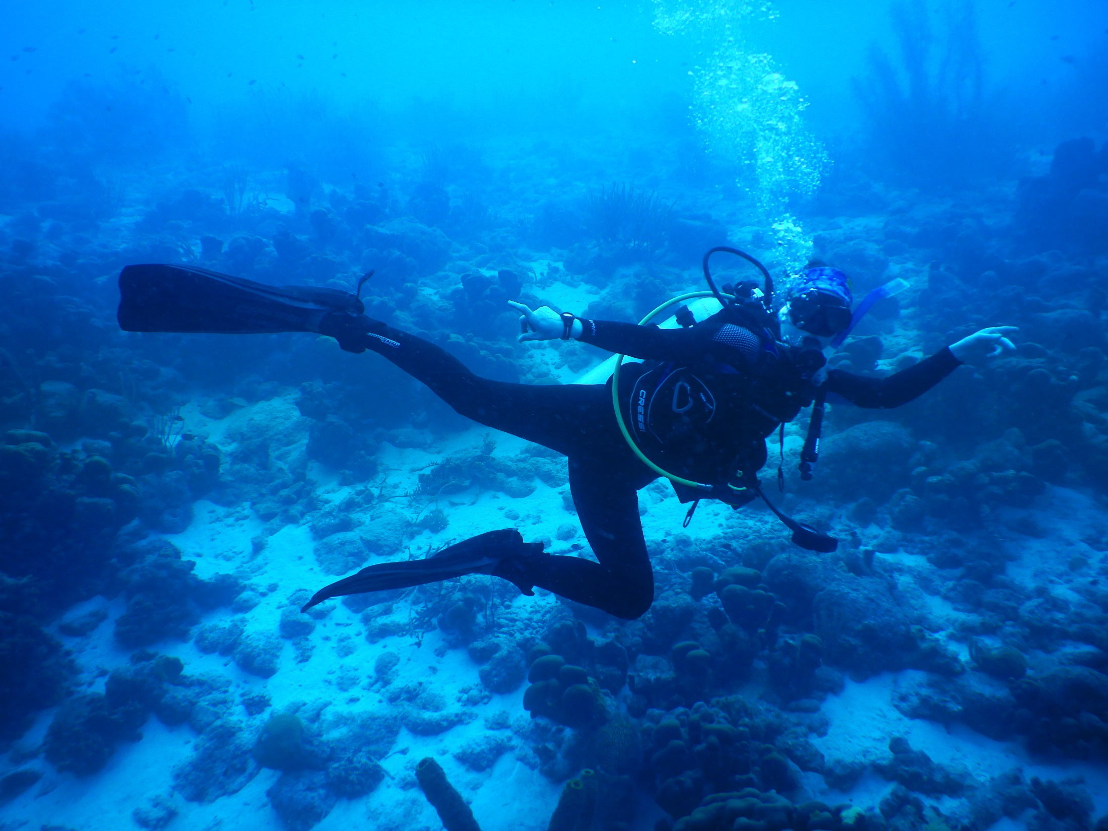
It’s truly awesome !!

Slide 20
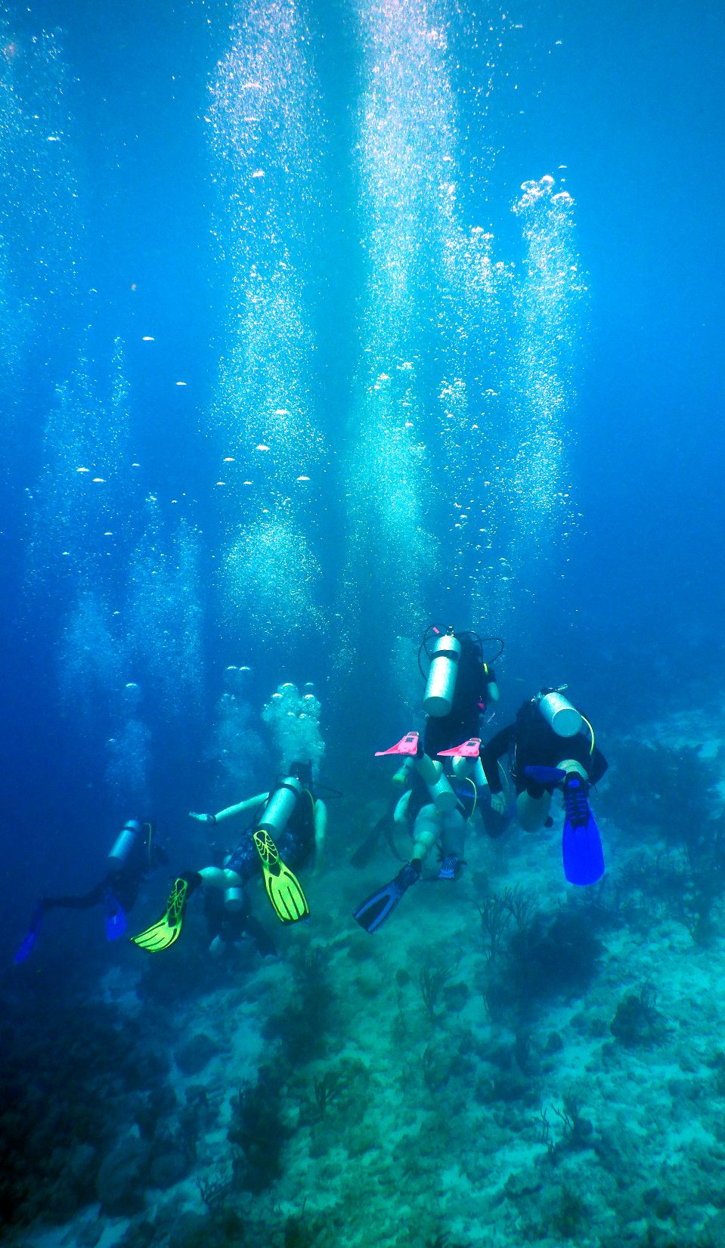
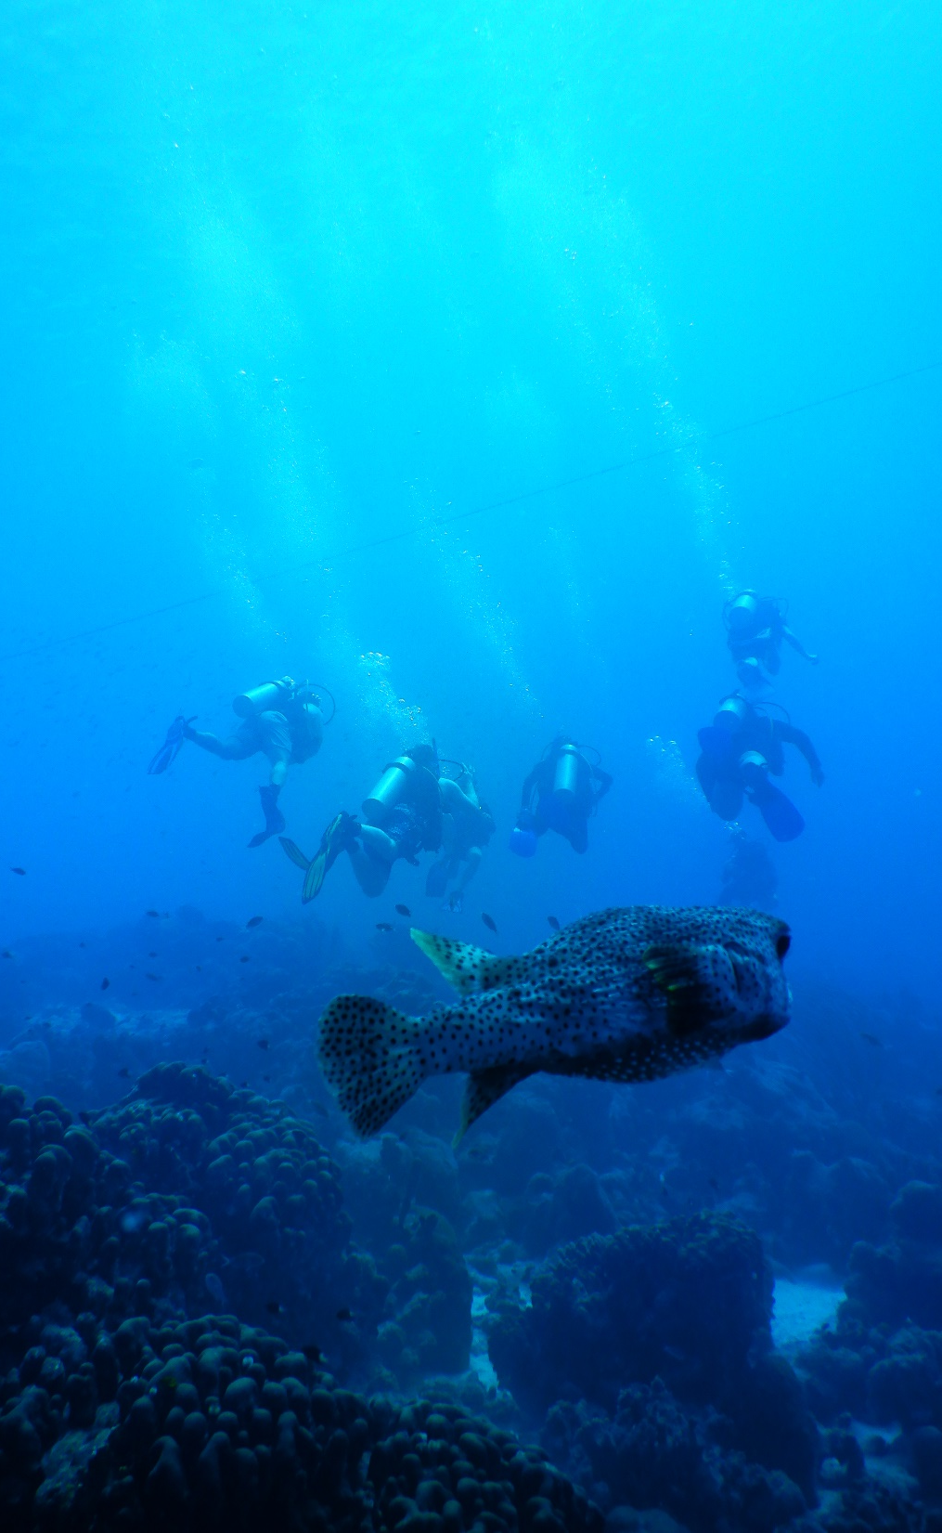

Slide 21
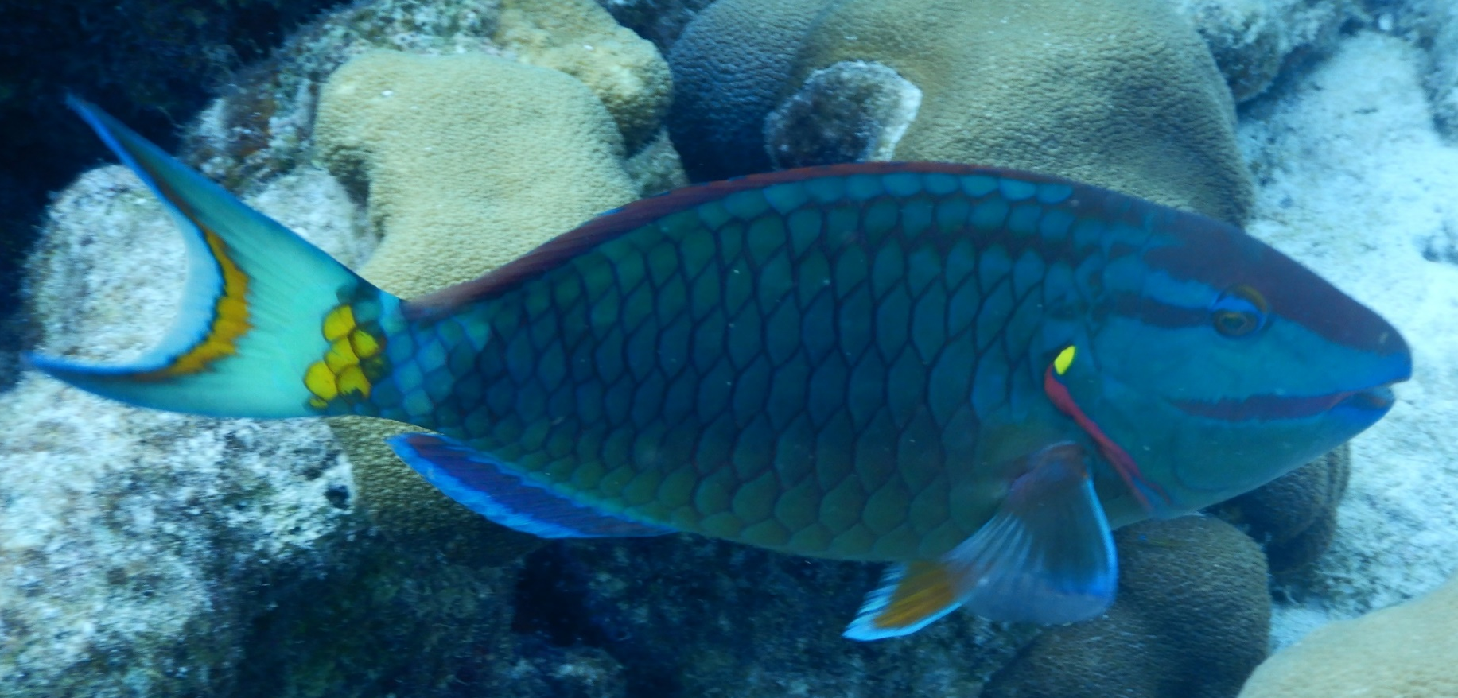
Just a few of the amazing creatures you’ll see…

Slide 22
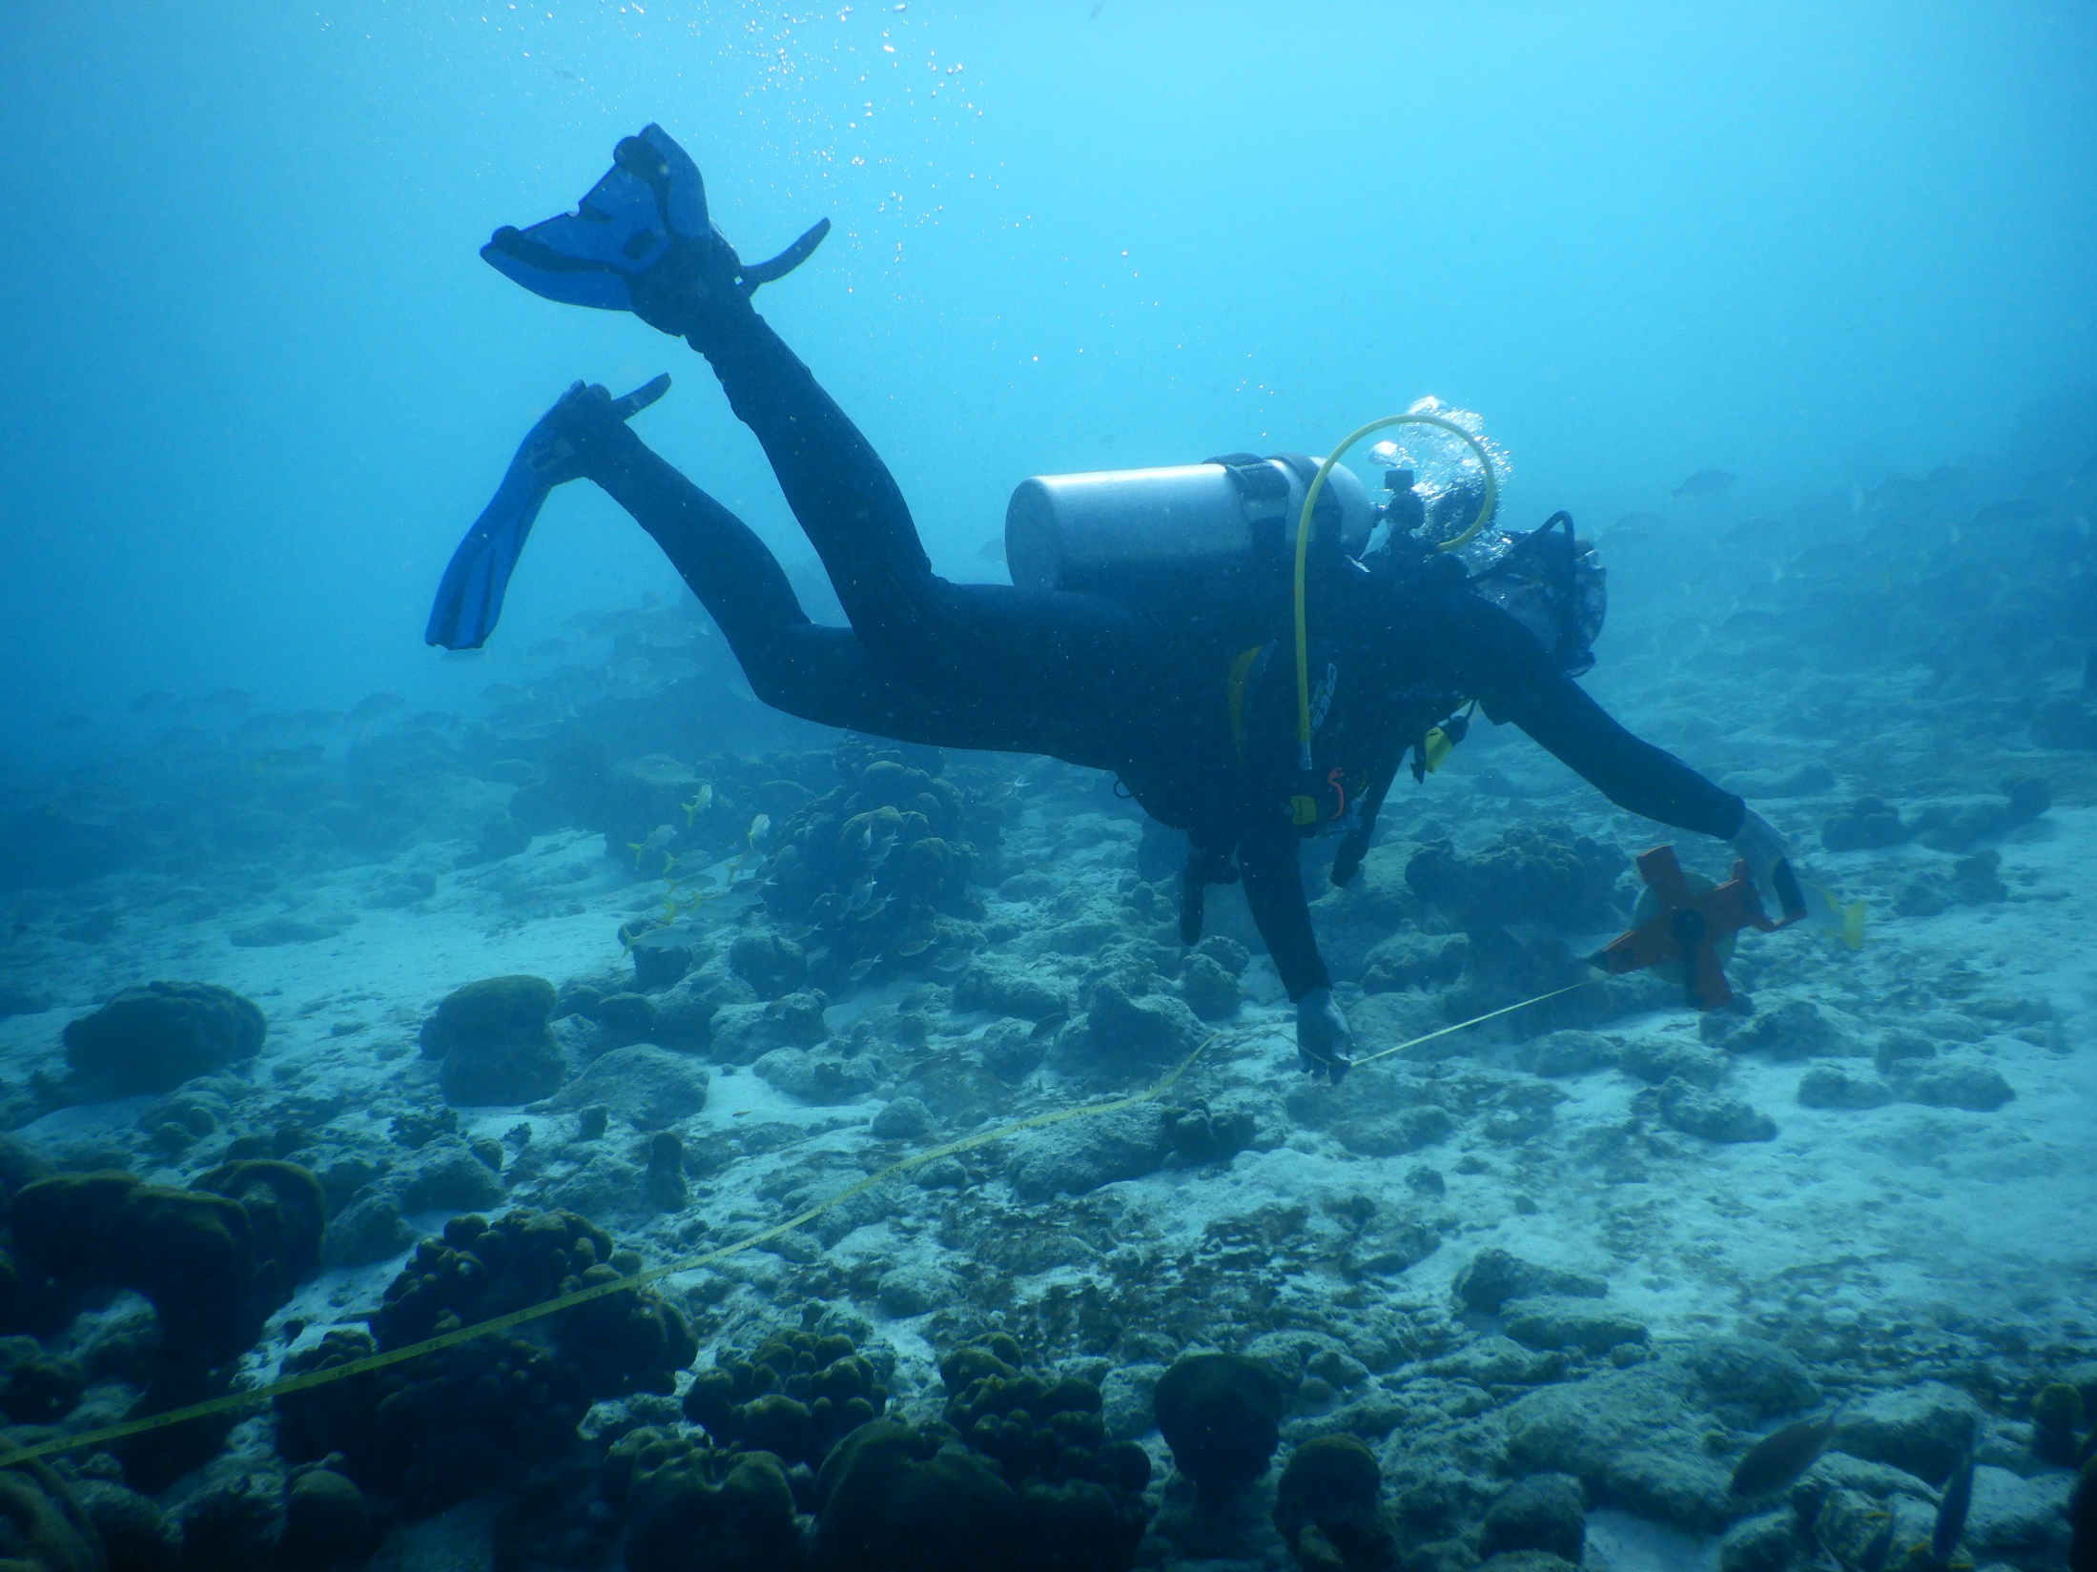
Underwater field work.

Slide 23
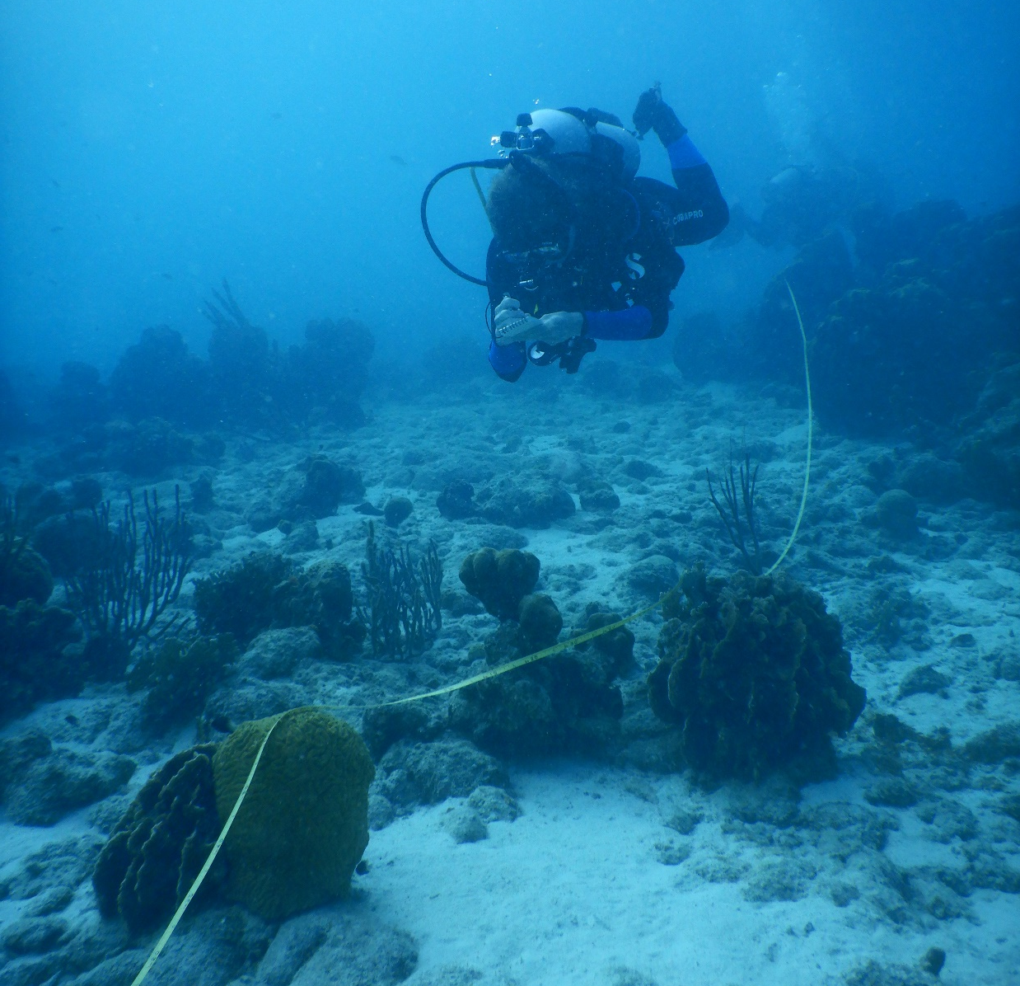
Surveying the coral reef.

Slide 24
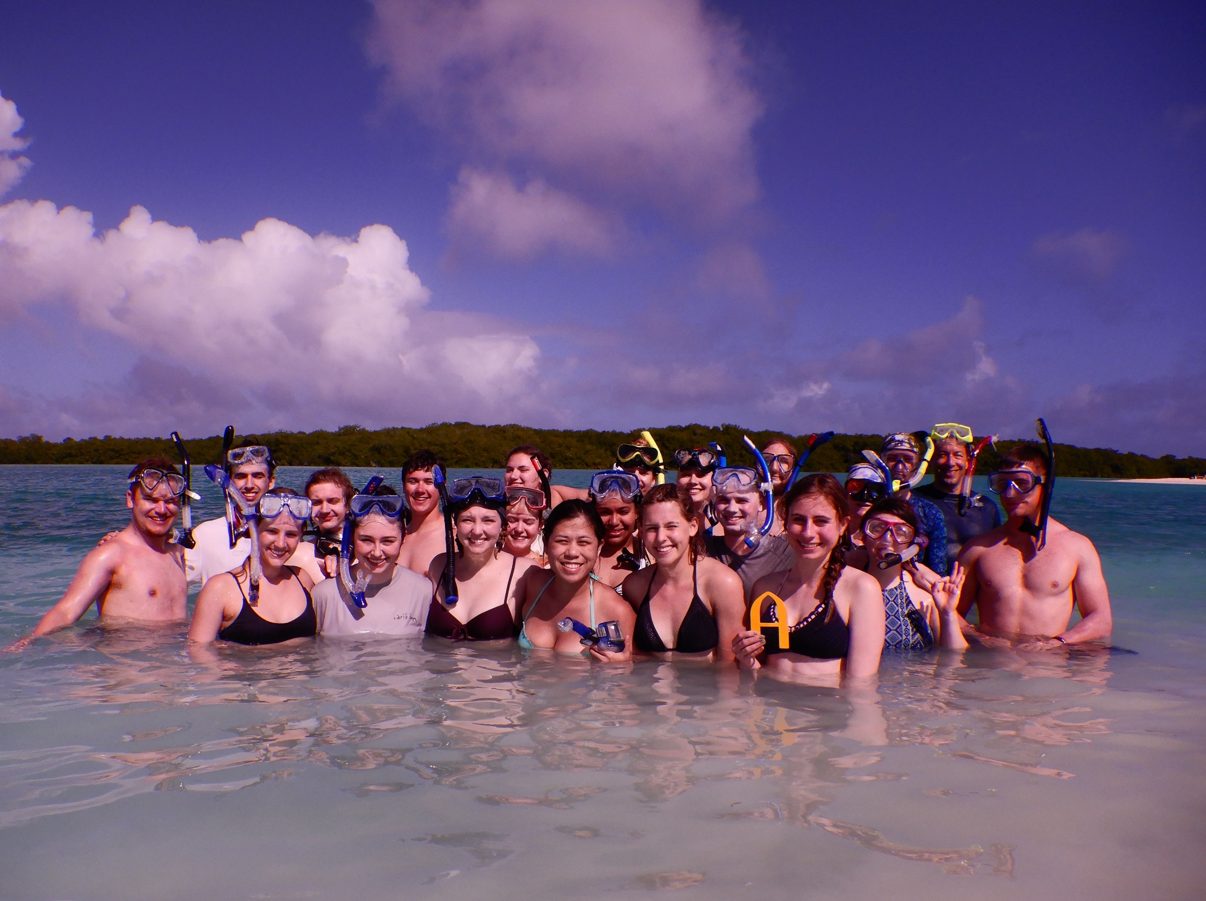
Just because it’s (field) work doesn’t mean it’s not fun!

Slide 25
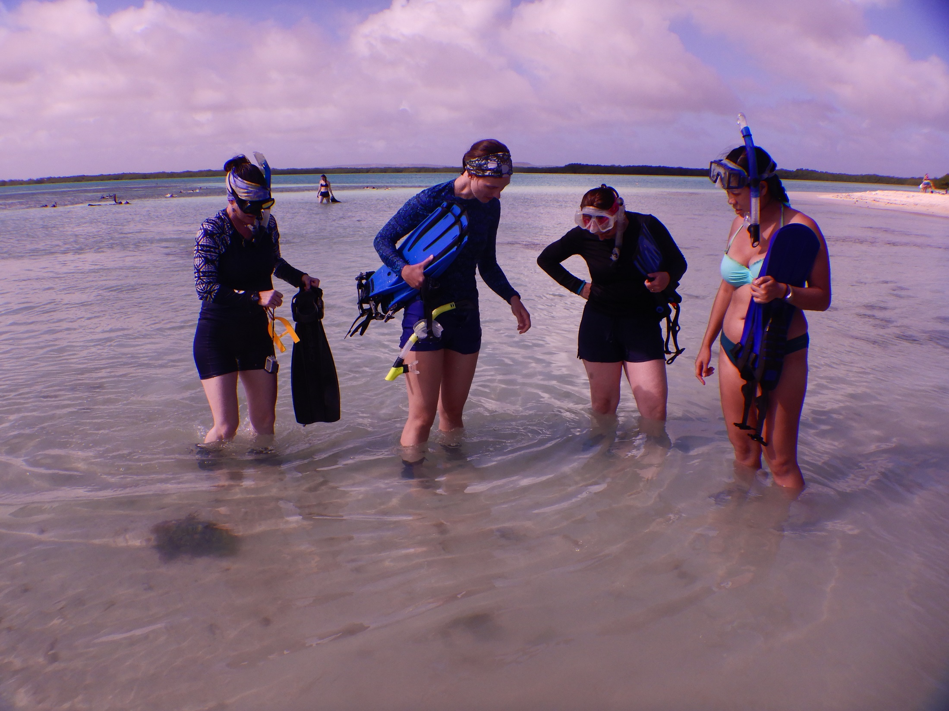
There’s so much to learn about the environmental interactions between
the biologic and geologic worlds, even in the shallowest of water.

Slide 26
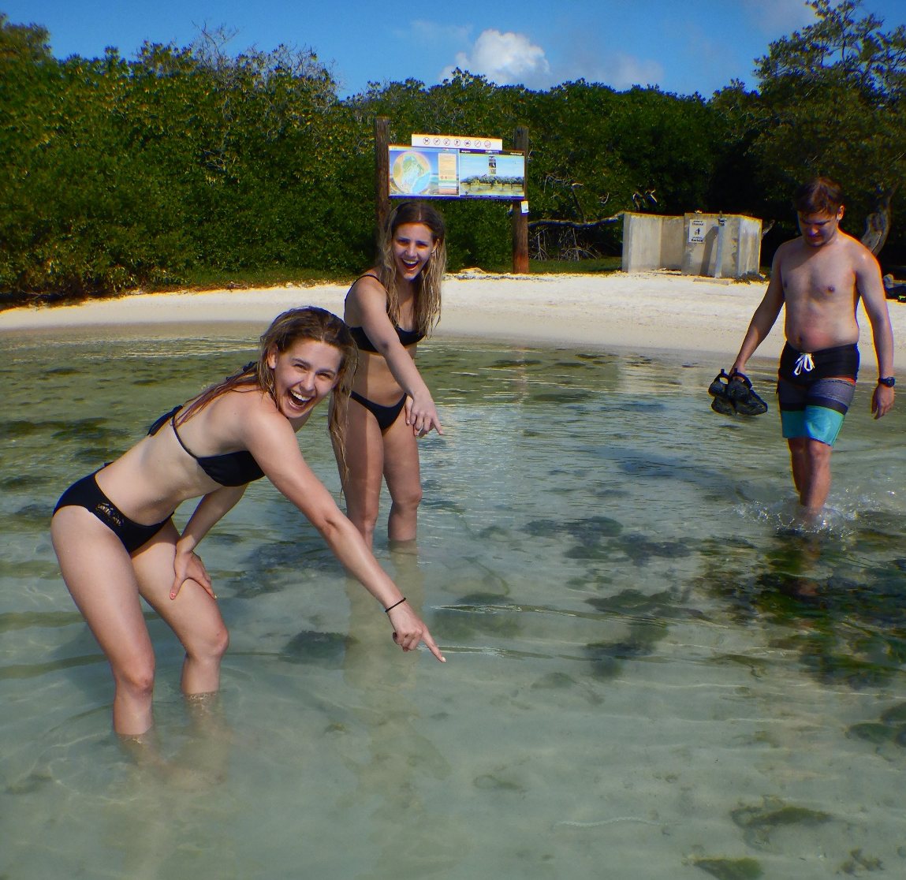
EEL !!

Slide 27
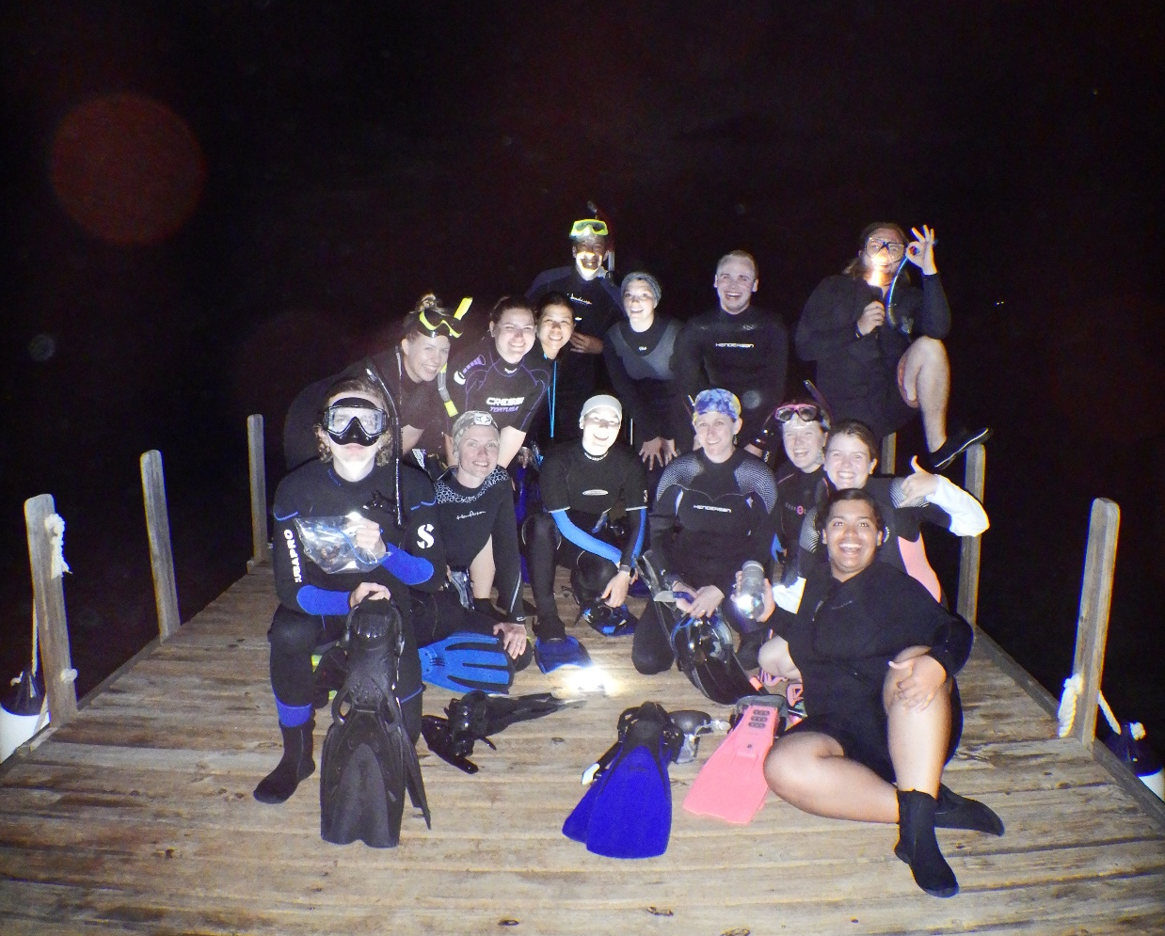
And there’s a whole other world of creatures that come
out at night for us to discover right off the dock!

Slide 28
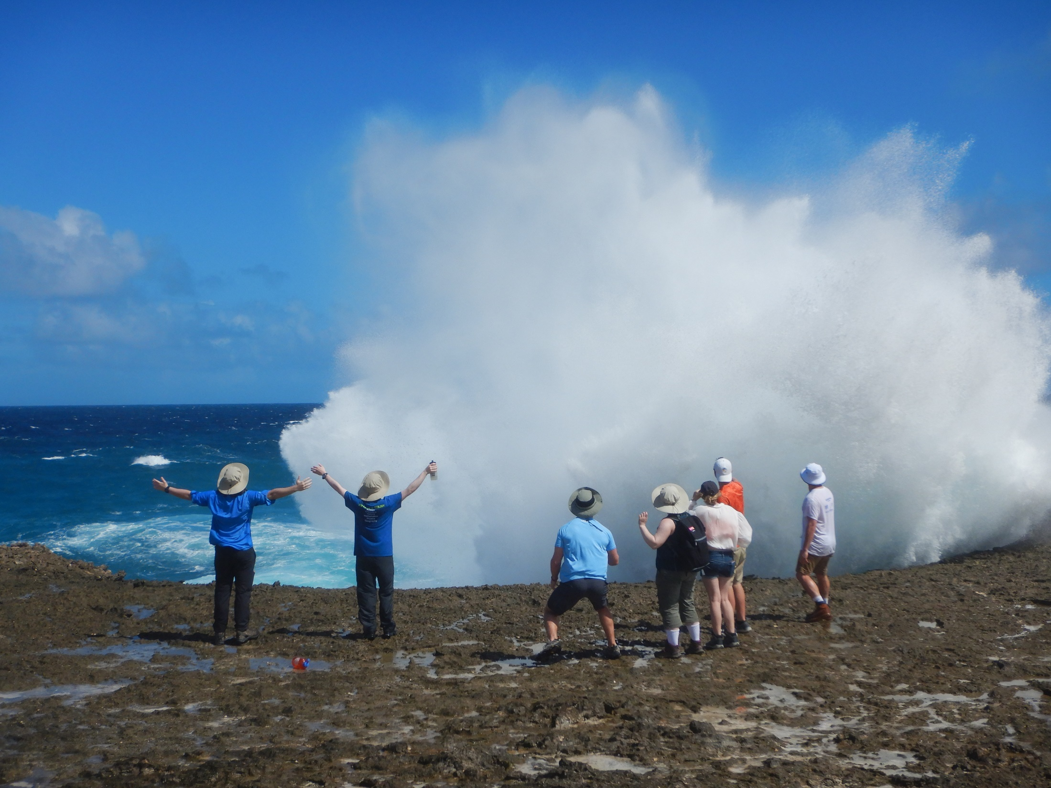
Observation of modern marine organisms is only part of the Bonaire experience.

Slide 29
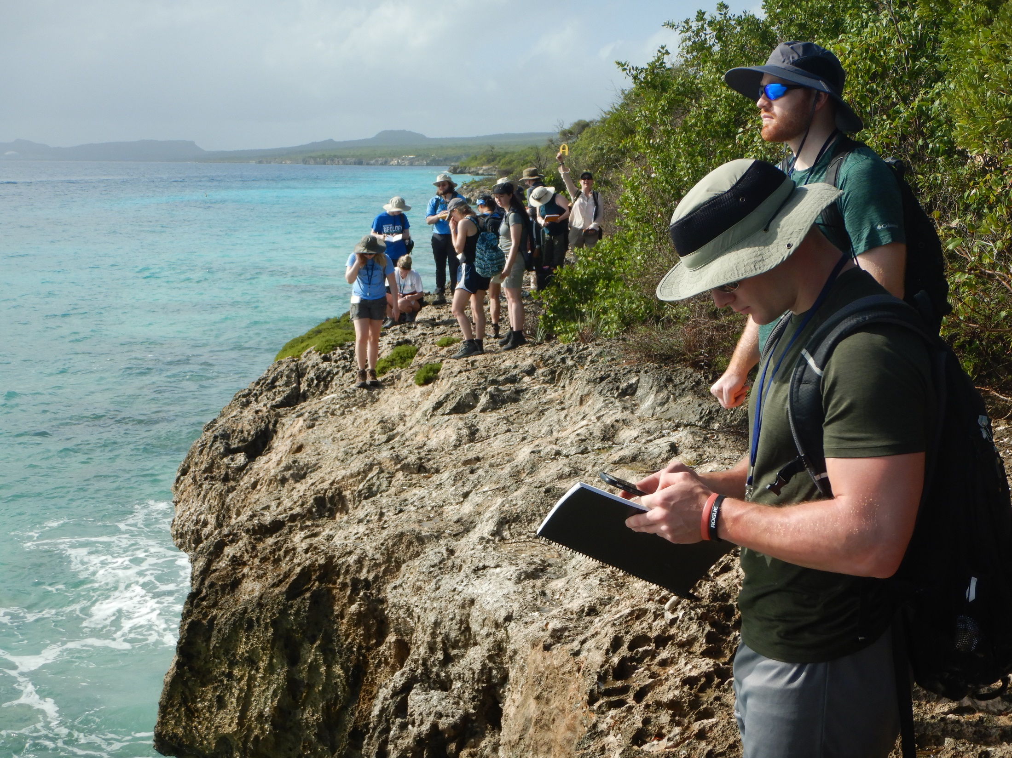
We’ll spend time right along the coast, studying those
ancient-to-modern and marine-to-terrestrial transitions.

Slide 30
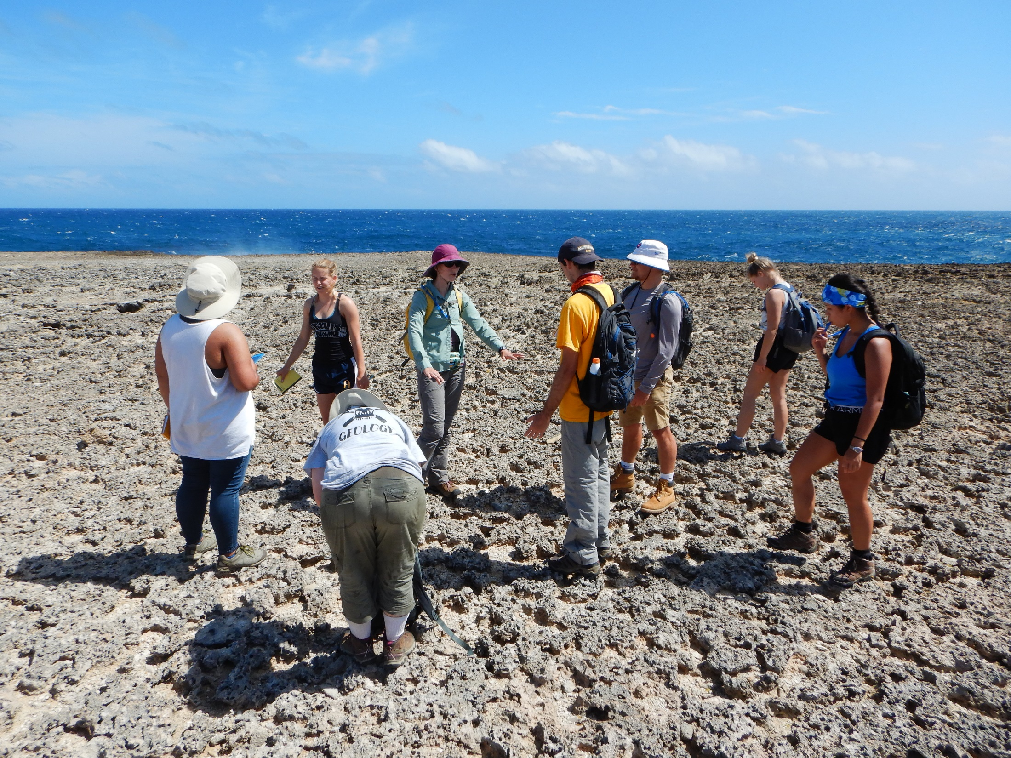
Uplifted, wave-cut coral reef terraces tell an ancient story.

Slide 31
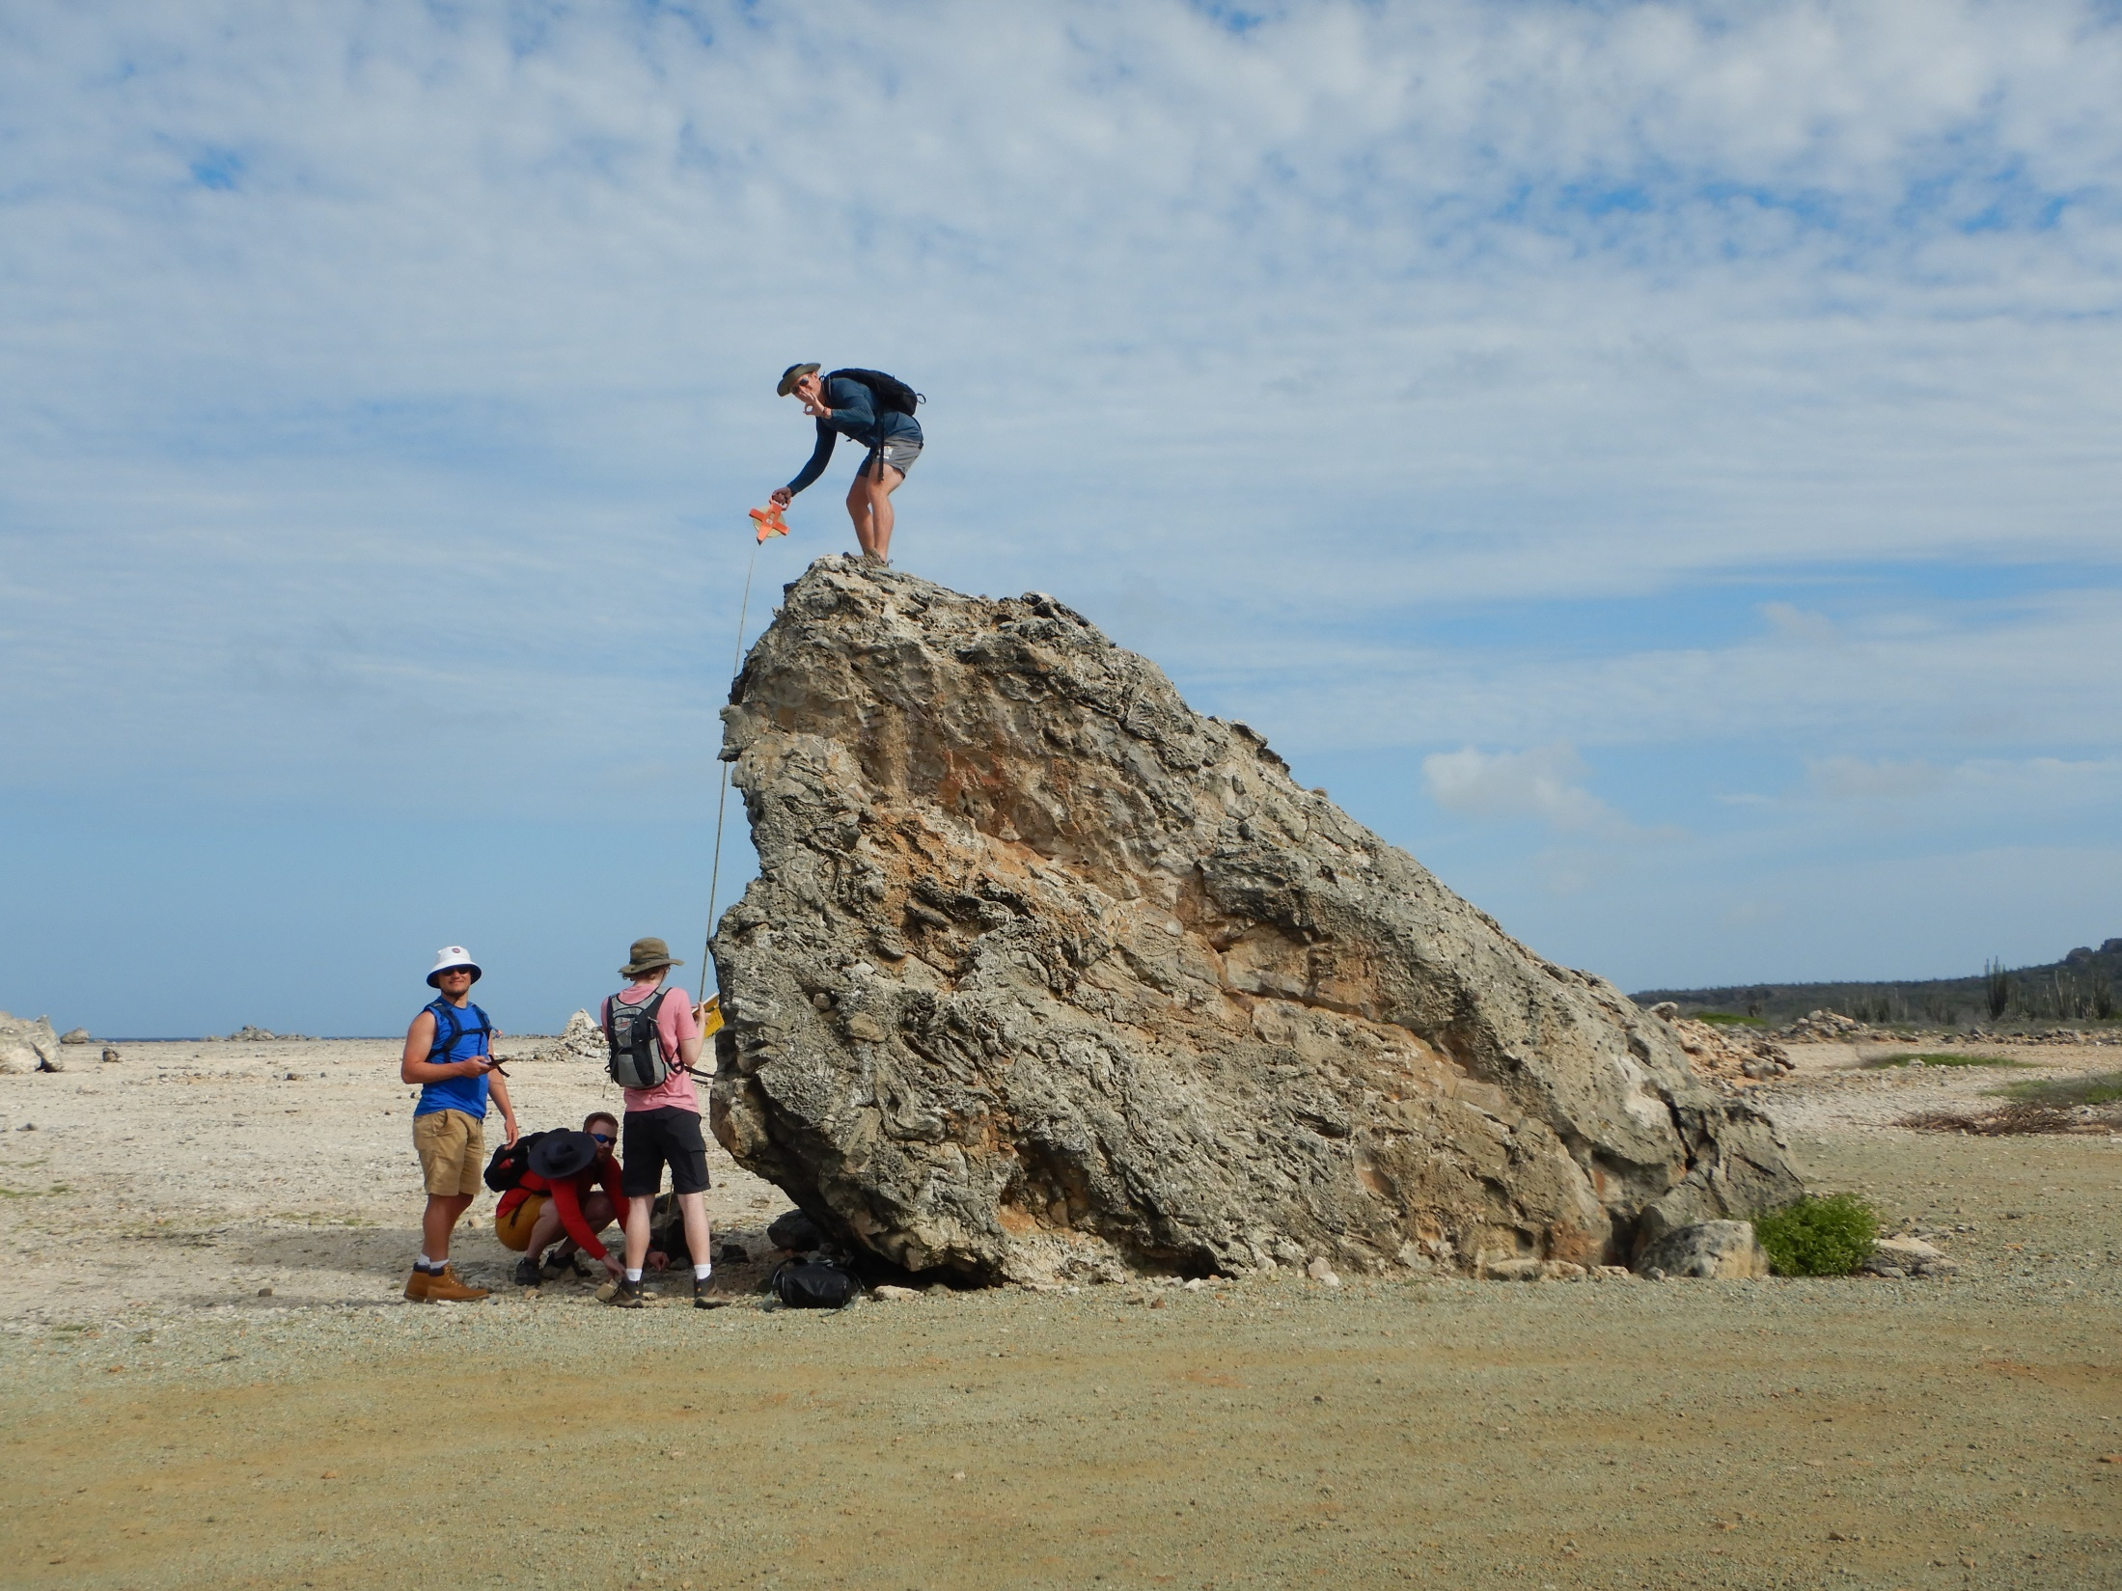
And randomly strewn boulders tell another part of the island’s history.

Slide 32
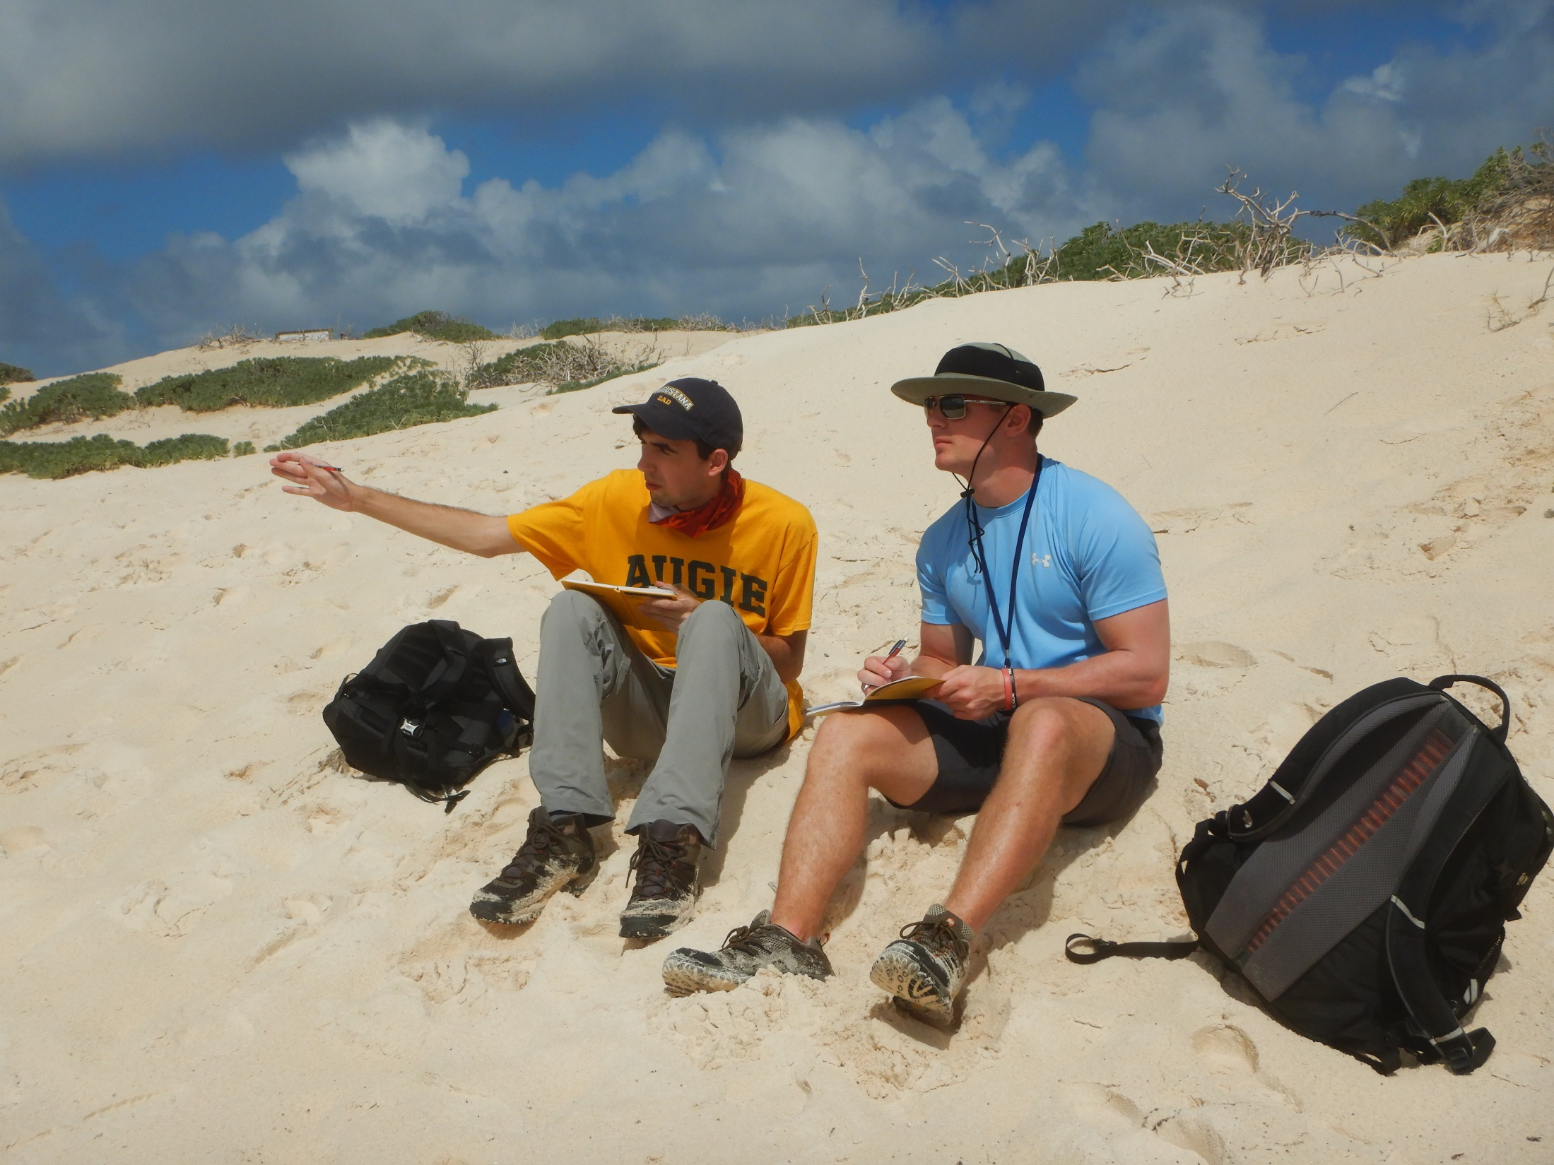
“My peak experience comes from my study abroad J-term in Bonaire in the Caribbean. The class associated with the trip was geology, which clearly has nothing to do with my field of study. Despite being out of my normal realm of studies, I learned a ton of new information and had the experience of a lifetime. From SCUBA diving to hikes in the national park, I will remember this experience for the rest of my life.”
from Chandler Behrens’ (’20)
“More Than I Imagined”
senior reflection
(economics & business
admin-finance major)

Slide 33
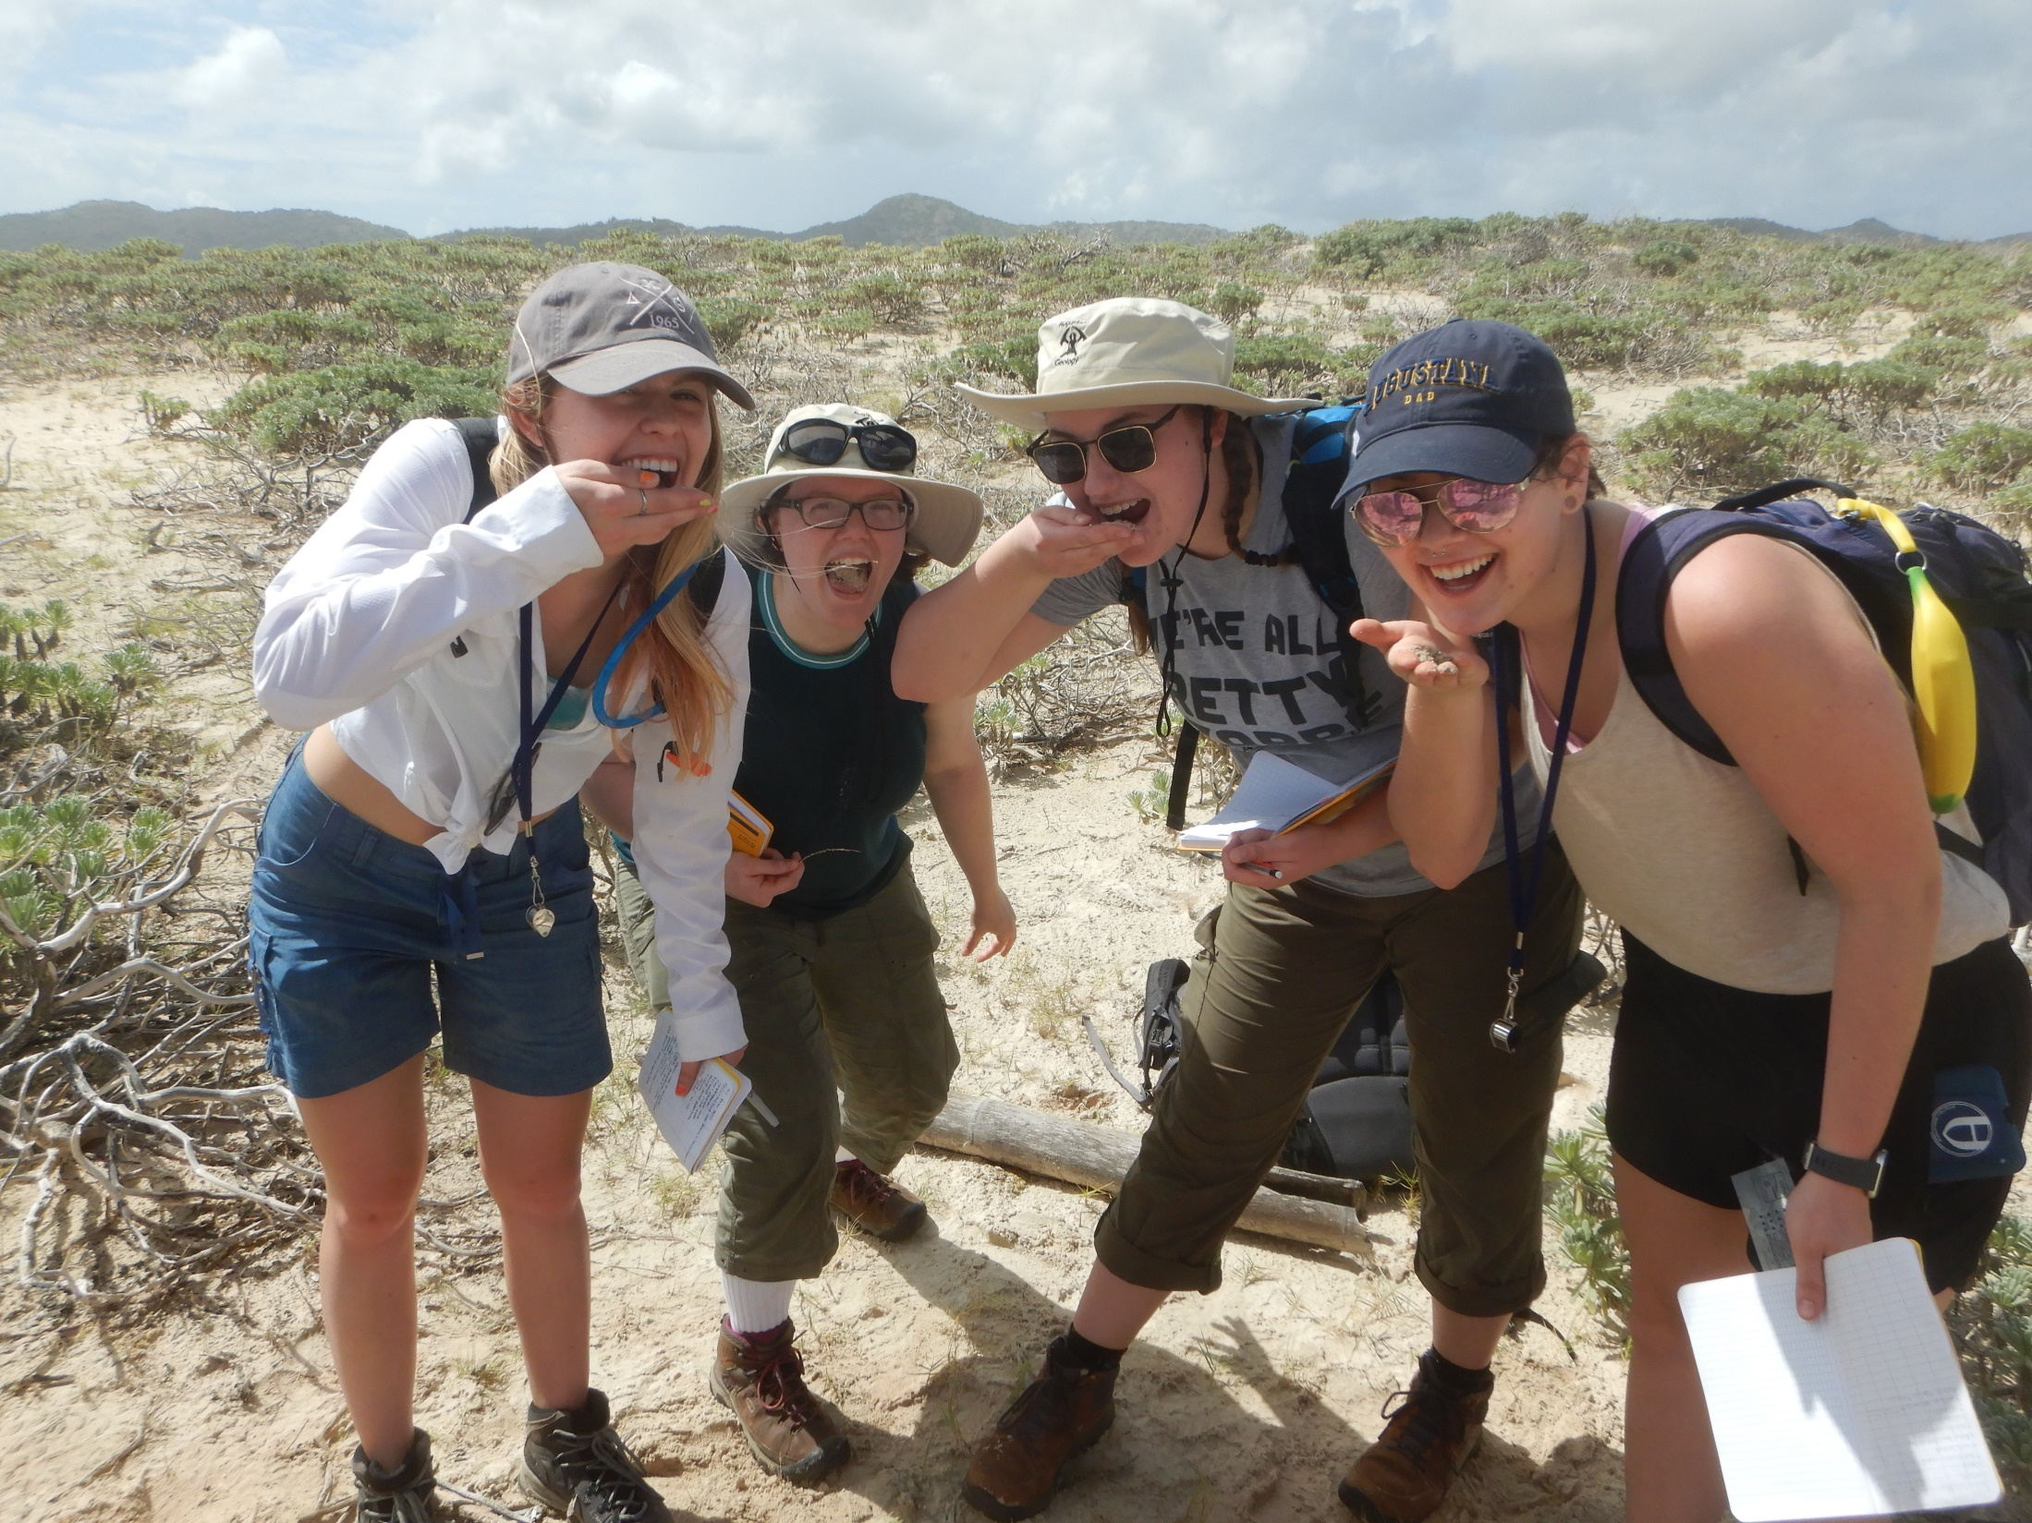
Sometimes “observation” means tasting the sediment for grittiness!

Slide 34
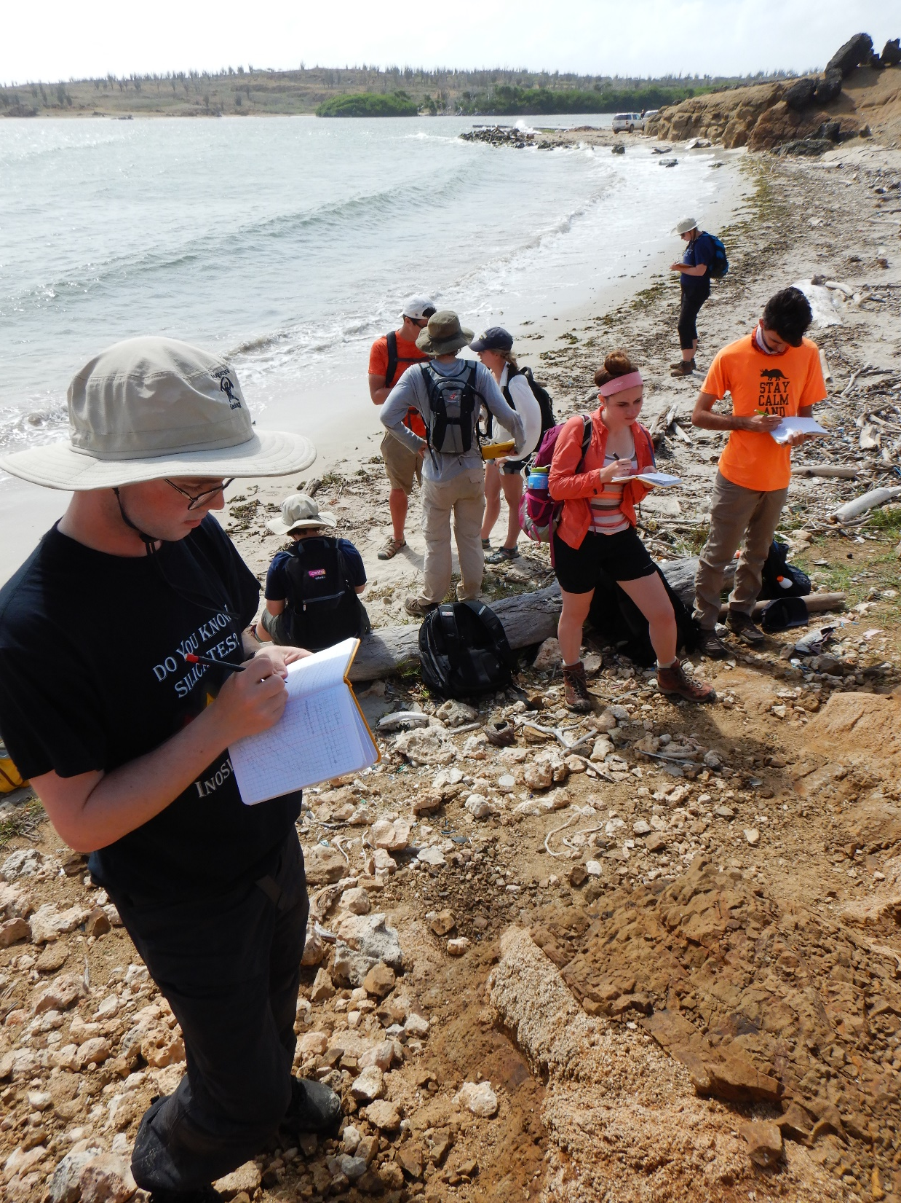
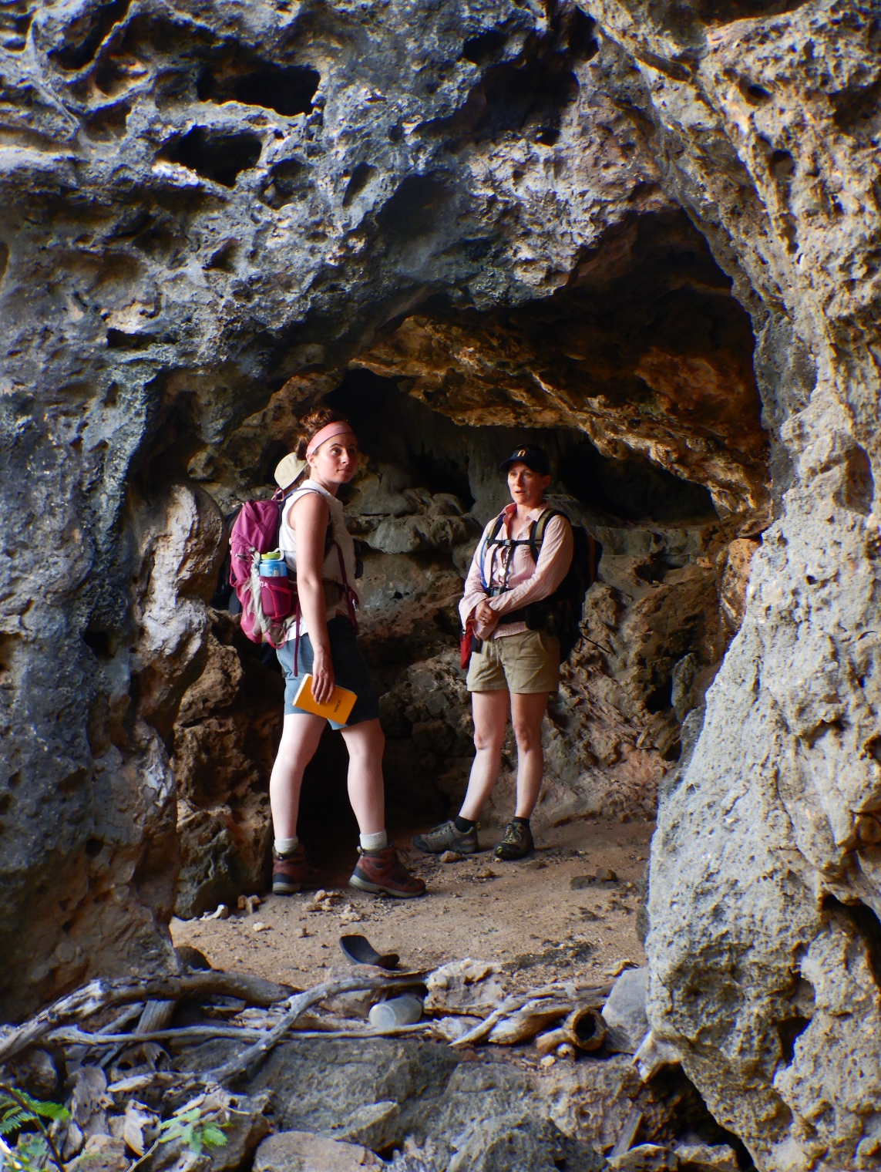
Exploring the landforms, from beaches to cliff caves.

Slide 35
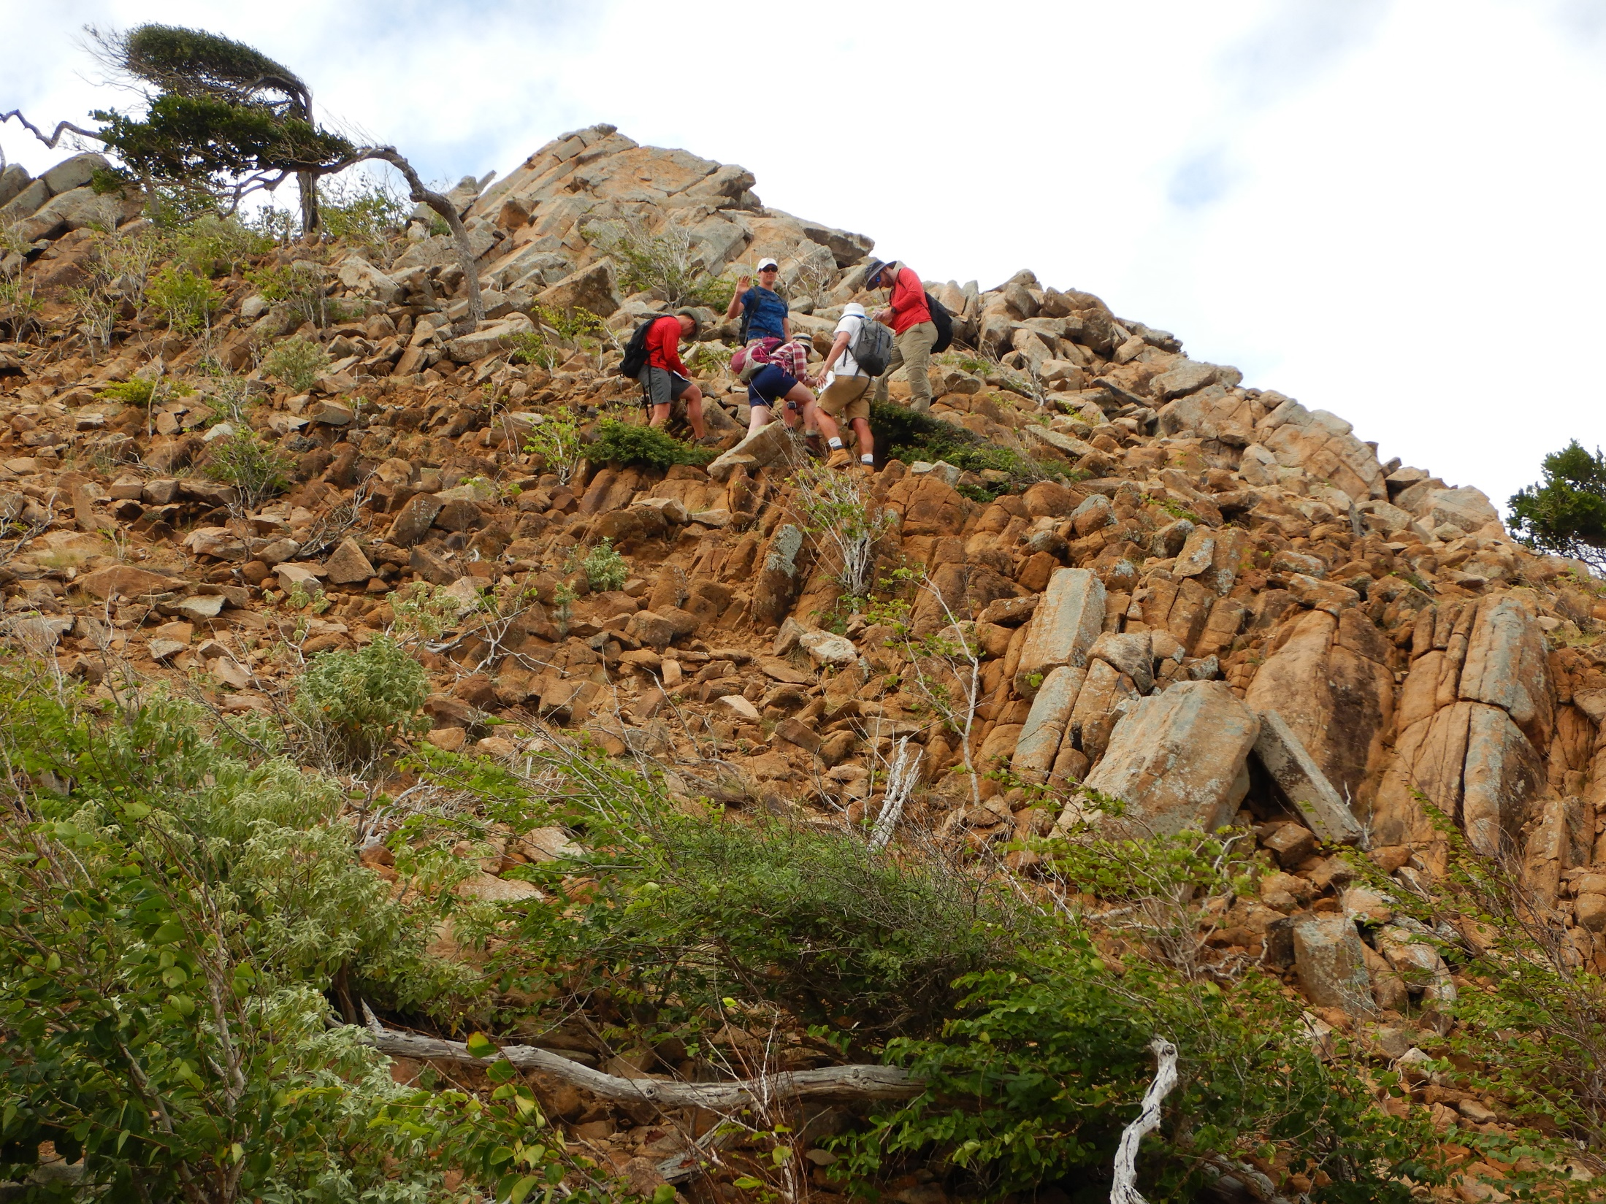
Scramble over fantastic volcanic
features while collecting data.

Slide 36
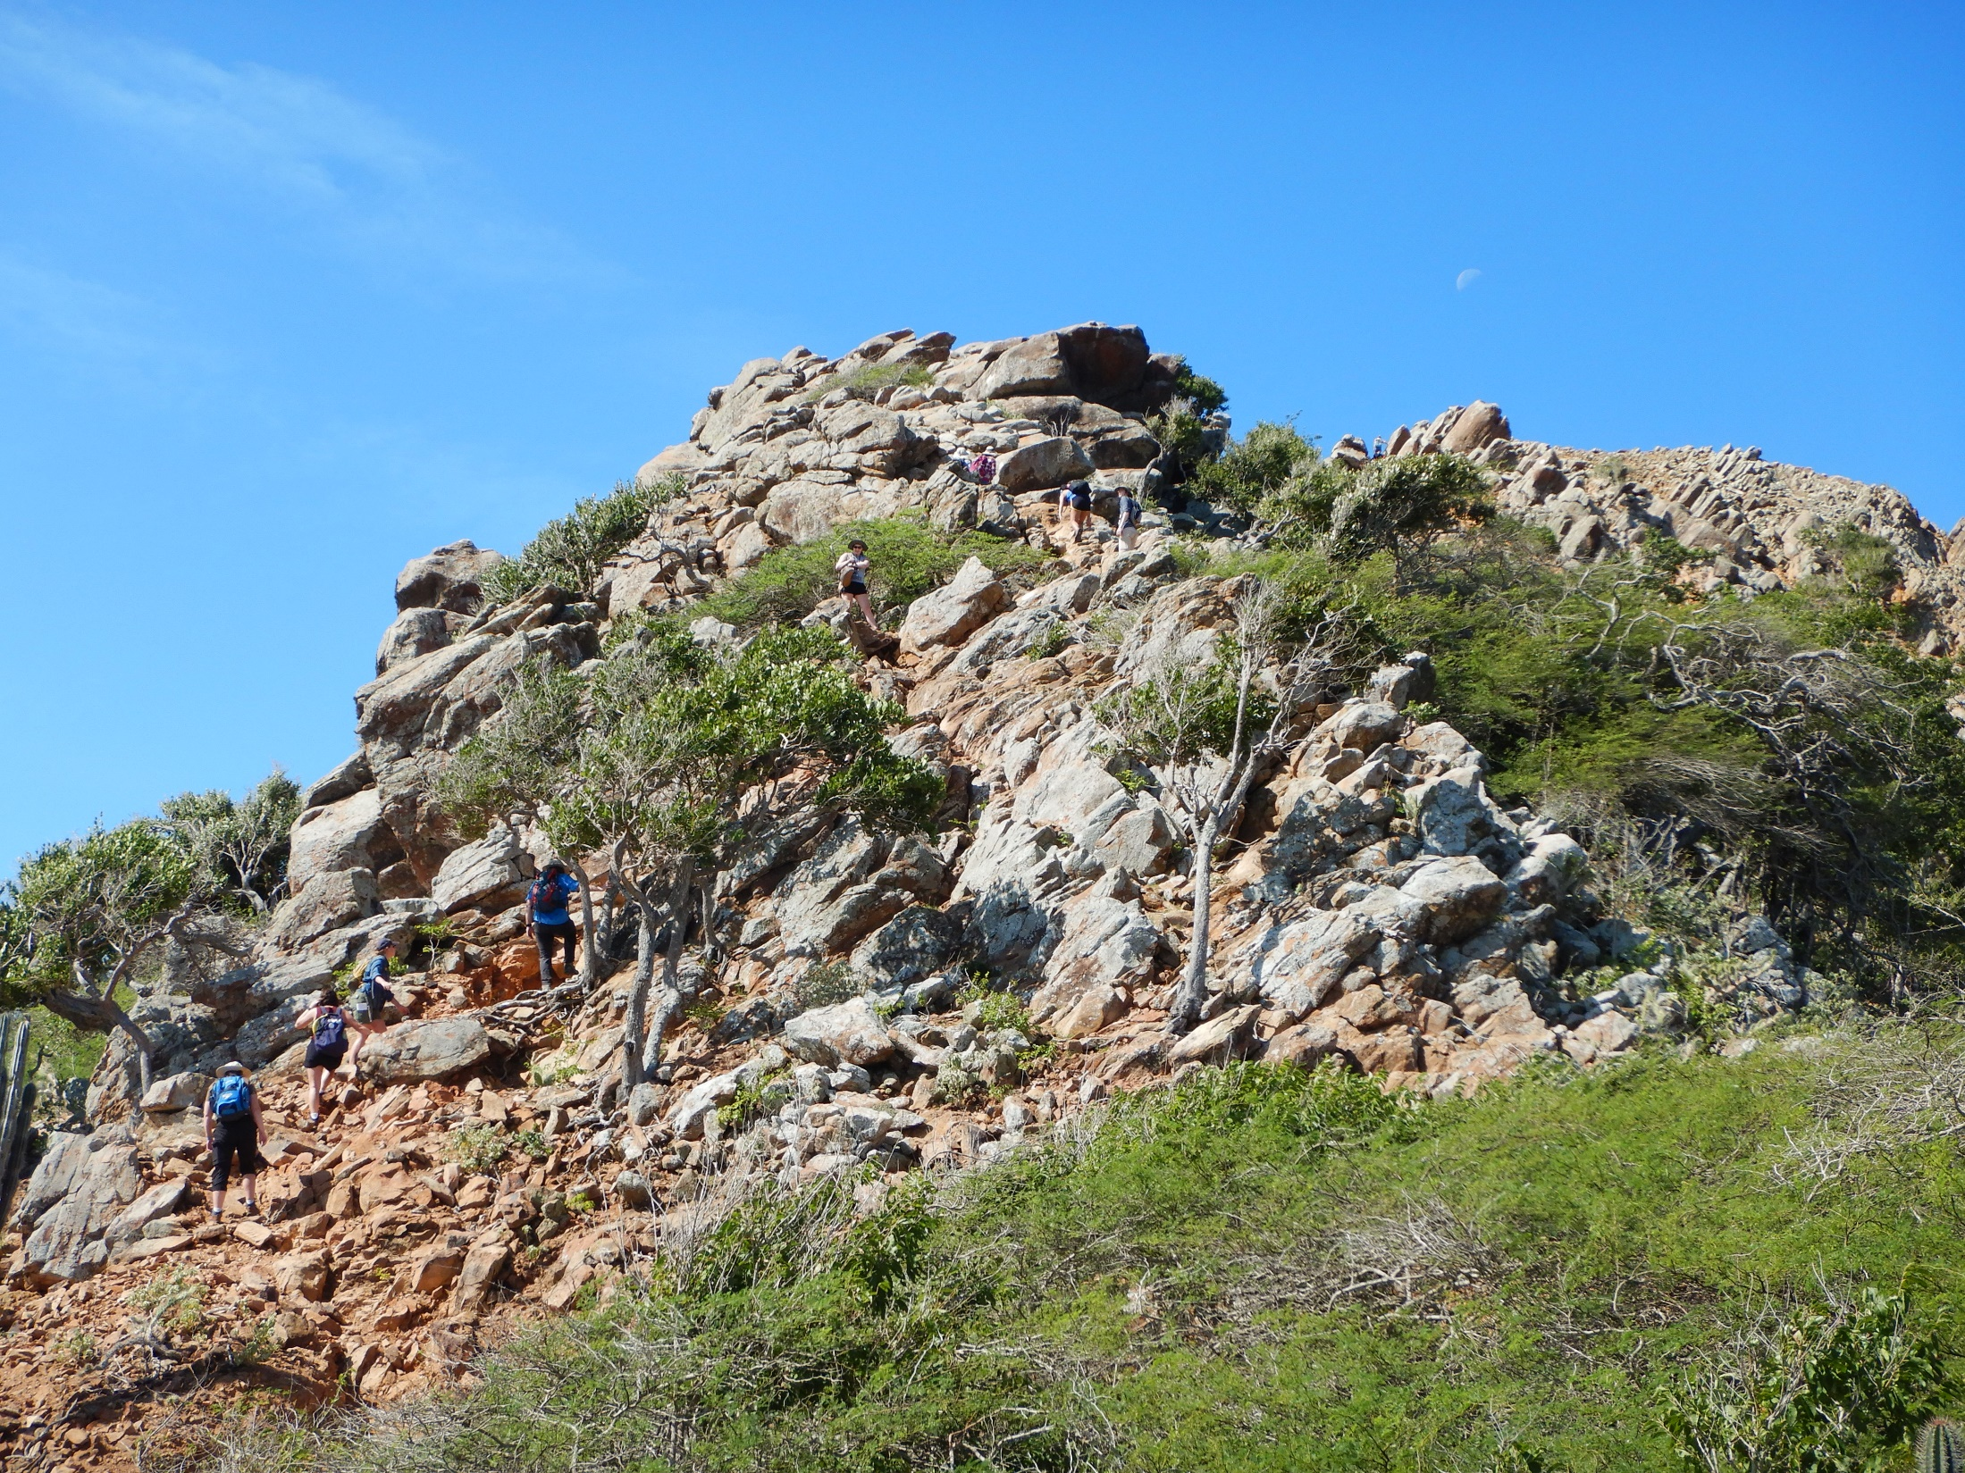
Then upward, to the mountain top.

Slide 37
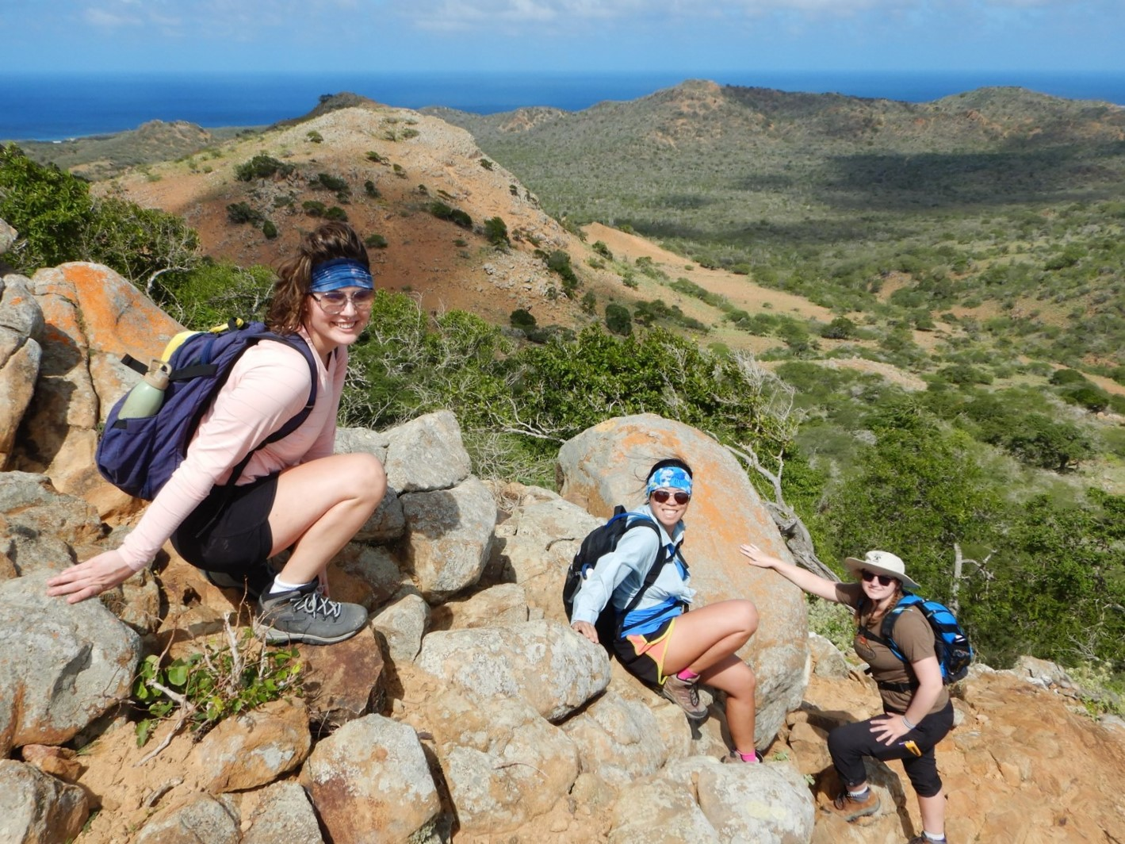
A beautiful view of the entire island.

Slide 38
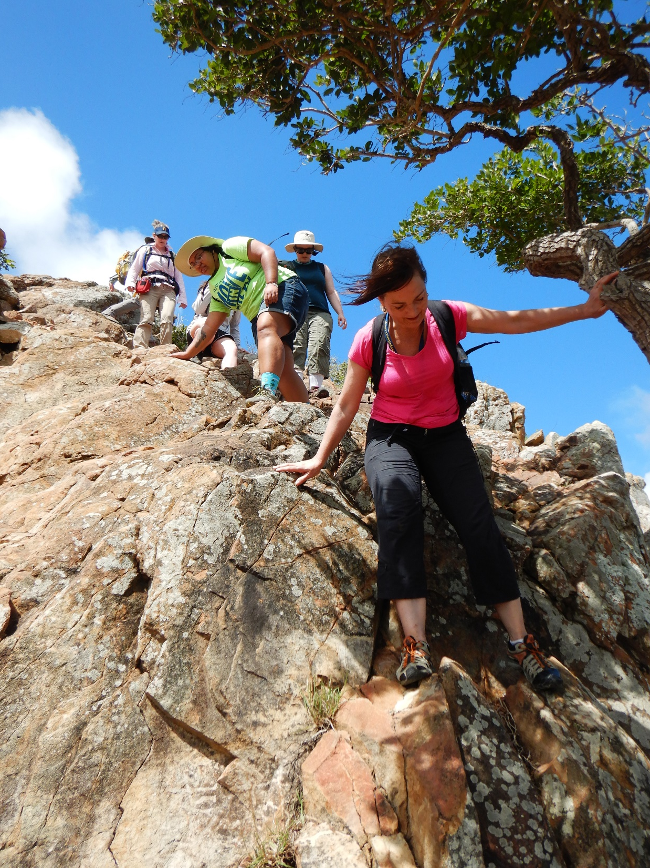
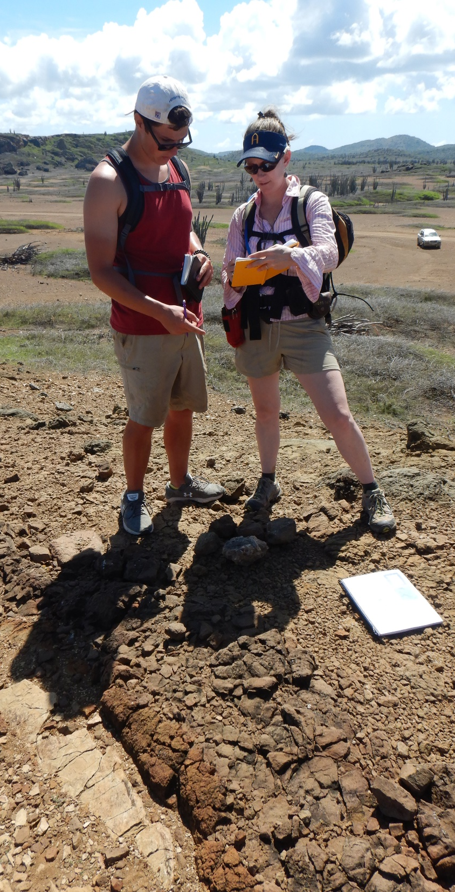
Studying the rocks all along the way
What goes up
must come down!

Slide 39
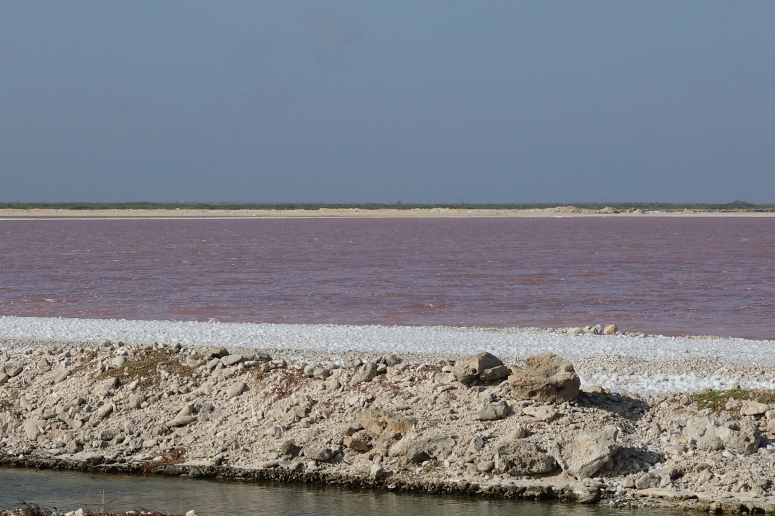
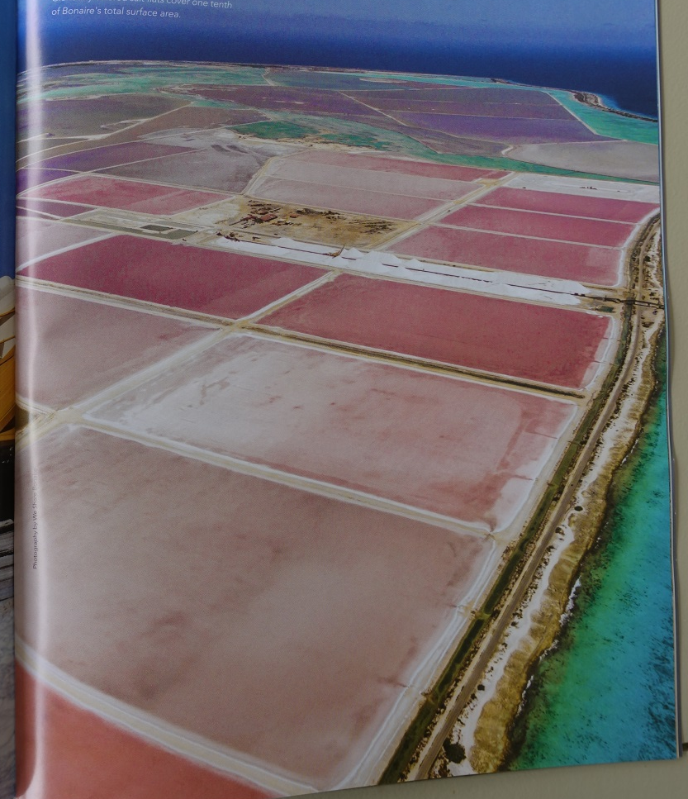
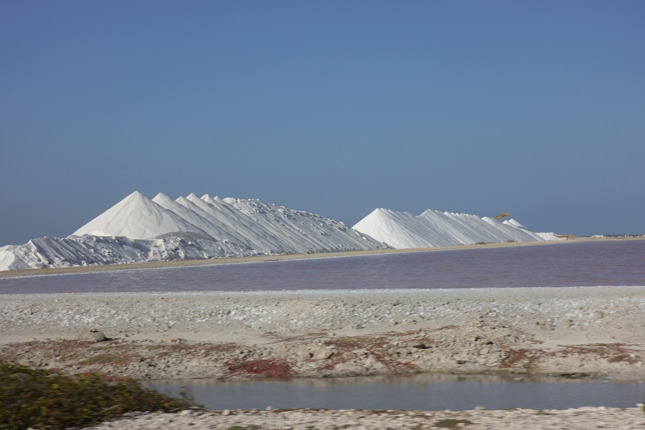
In addition to our main focus on developing an understanding of the bio-geologic environmental history of Bonaire, we will also investigate one of humanity’s longest running activities – the extraction of Earth’s mineral resources for economic benefit. On Bonaire, evaporation ponds for halite (salt) production is a centuries-old (and still) big business.
Pink algae makes pink water, pink salt, pink shrimp and…
Bonaire Affair 2018 mag.

Slide 40
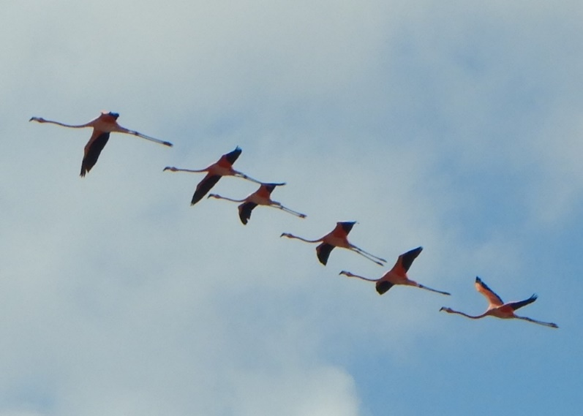
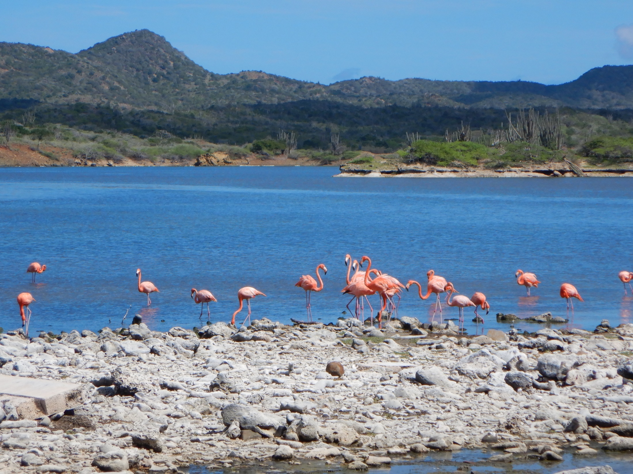
… PINK BIRDS !!

Slide 41
We will also grapple with another of humanity’s longest running activities – the exploitation of human resources for economic benefit – slavery. On Bonaire, slave quarters have been preserved as a reminder of what can transpire if human rights are ignored. During this month in which we celebrate MLK day, we will bear witness to humanity’s ability to dehumanize others who may differ from us.

Slide 42
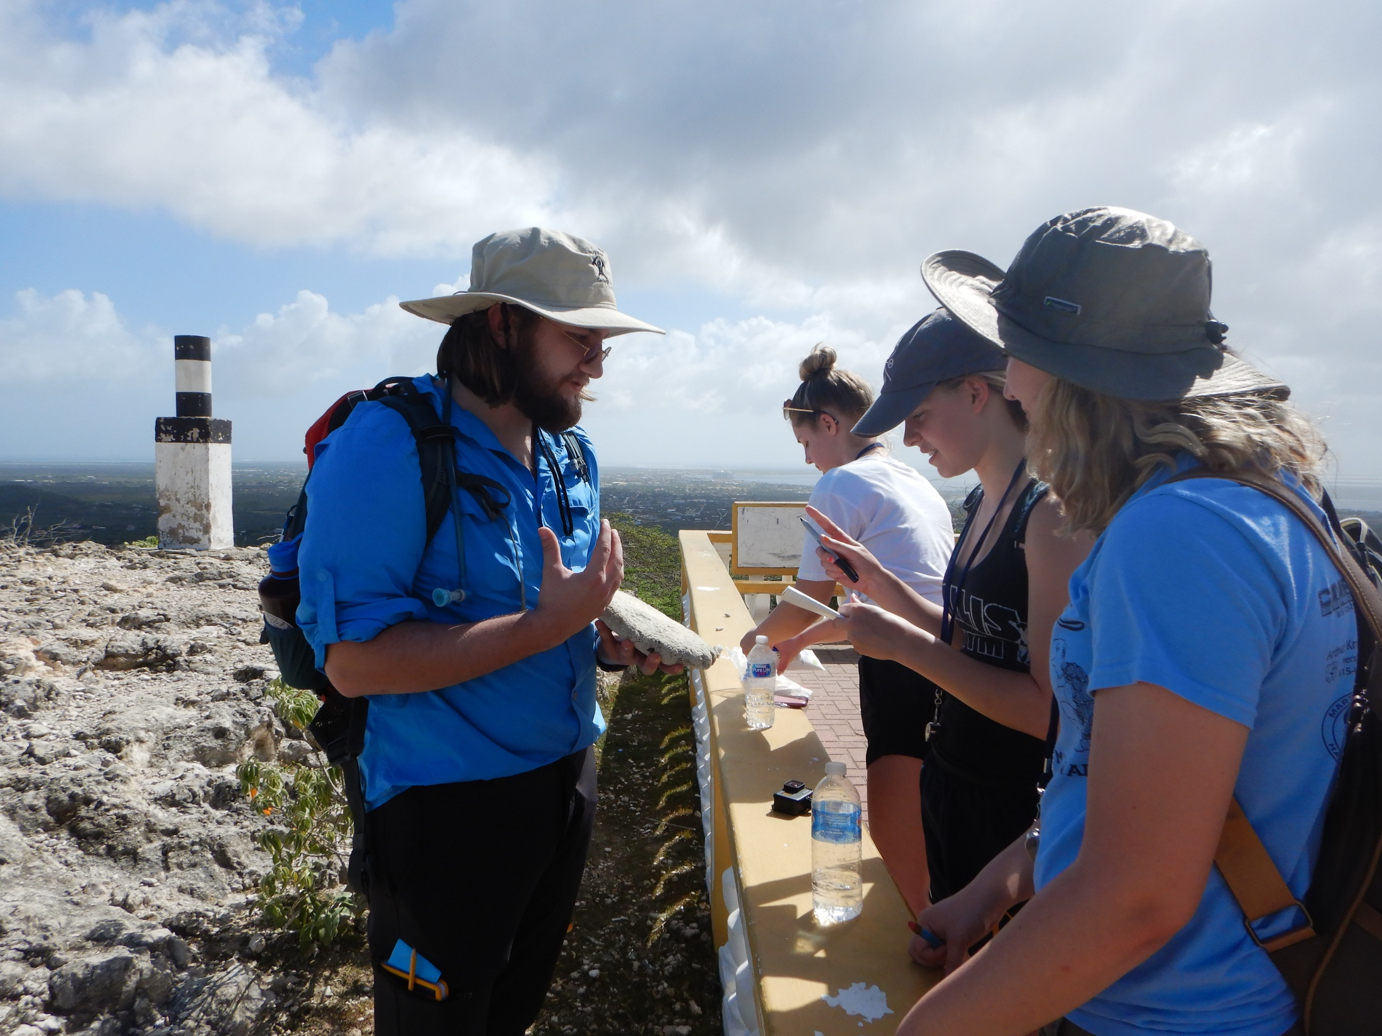
There is much to learn in three weeks. Field work is generally an 8 am to 5 pm endeavor. Students teaching students is an important part of the experience.

Slide 43
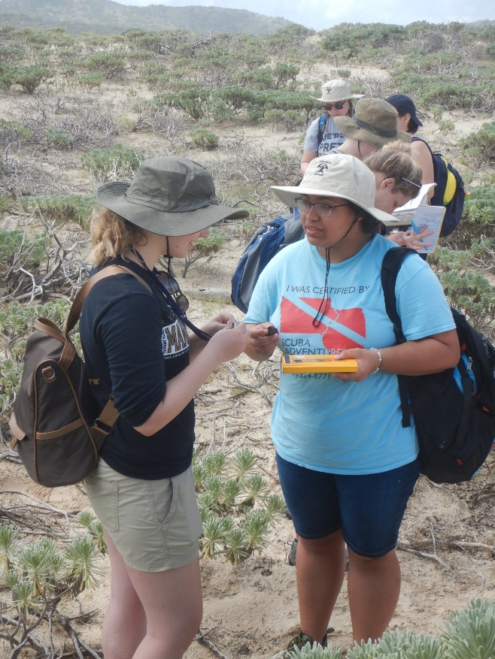
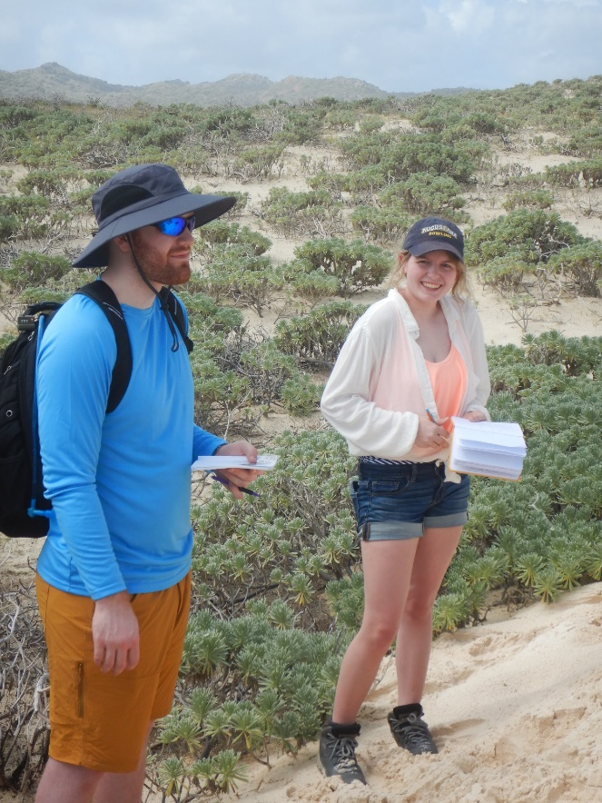
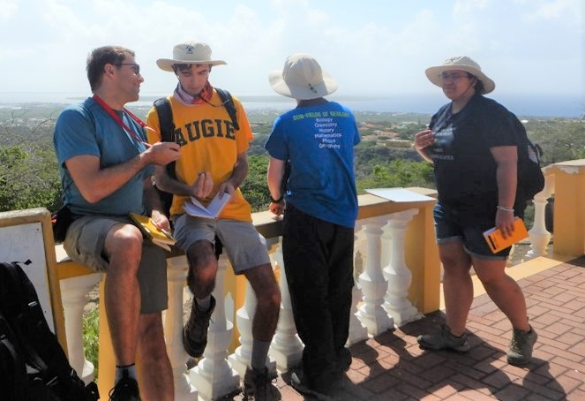

Slide 44
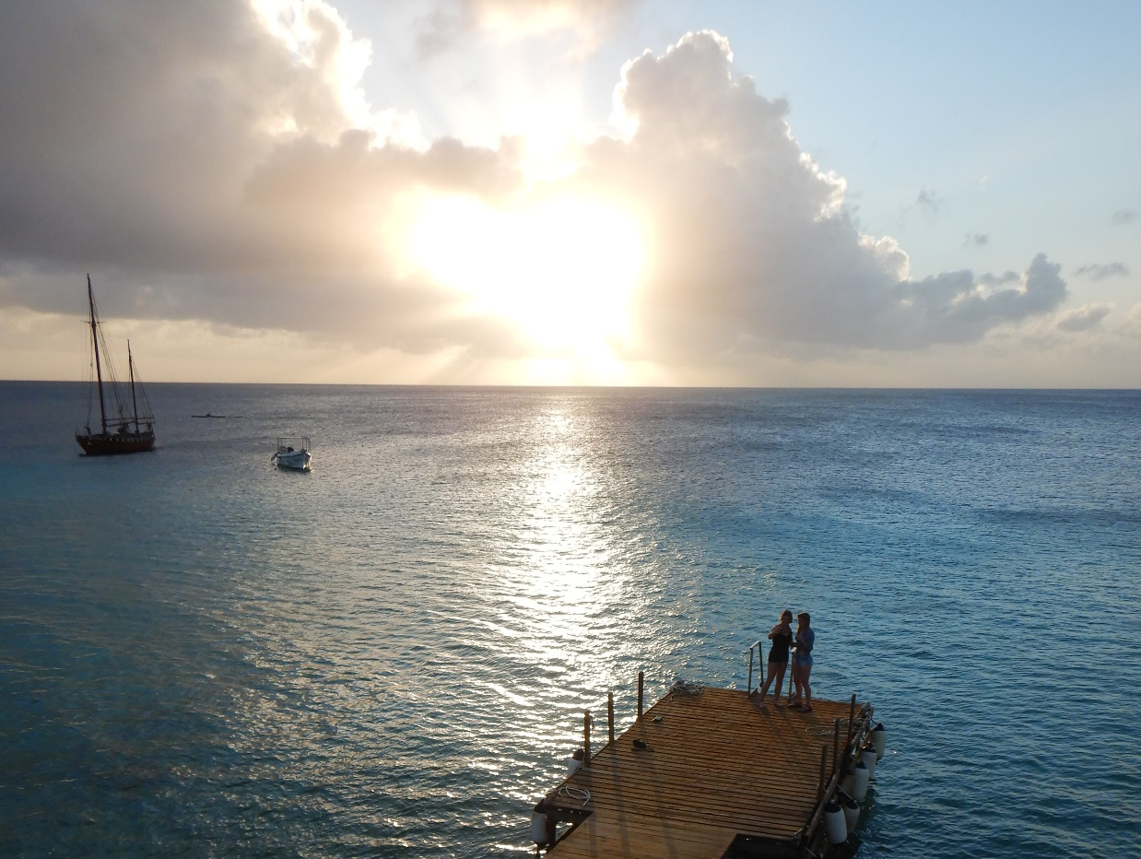
As hard as we work, there’s still
plenty of time for rest, relaxation
and quiet contemplation.

Slide 45
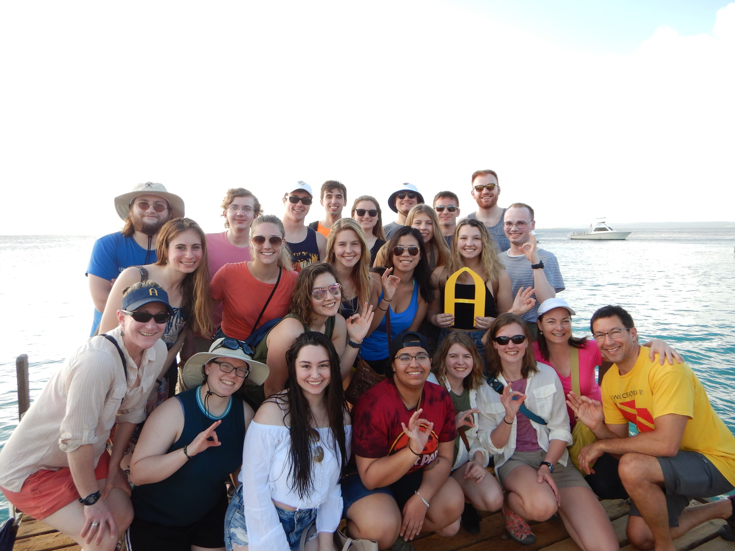

Slide 46
Why
Bonaire
for J-term?
Because there’s cool geology and warm weather!

